Slide 1
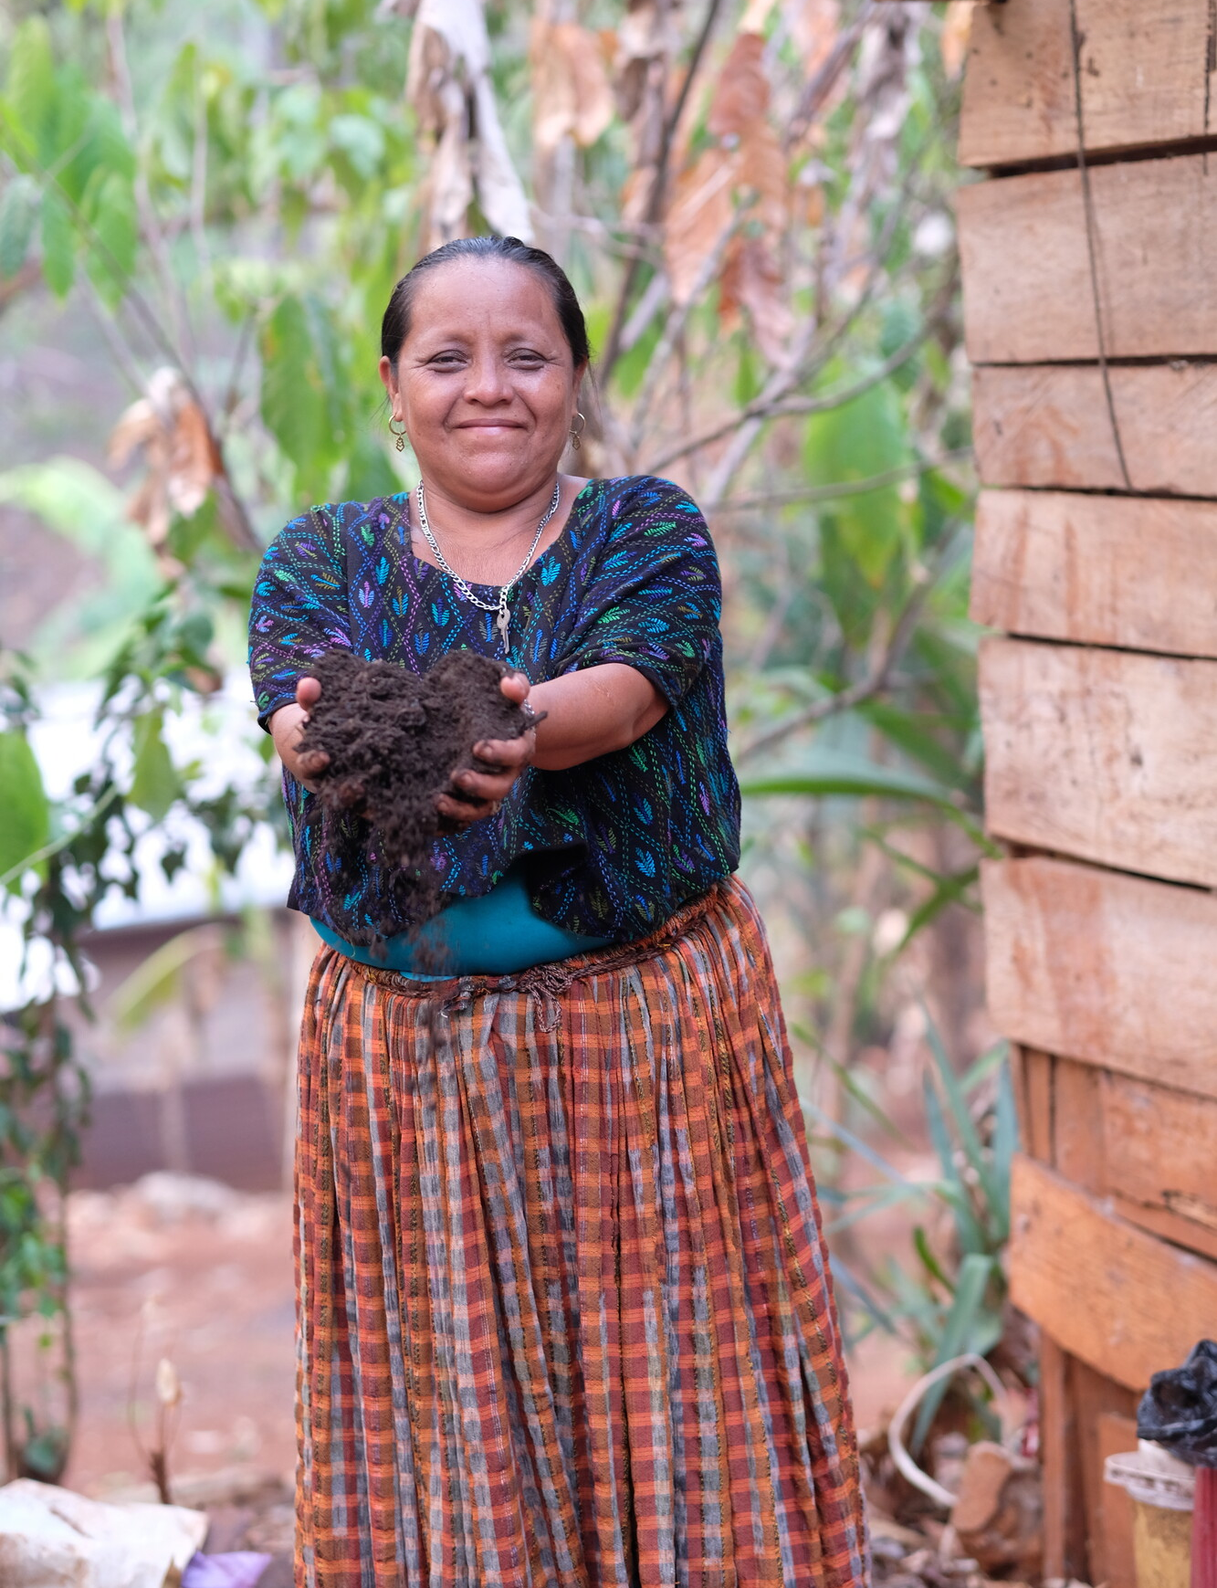
Abounding hope
Christian Aid Week 2025
‘…abound in hope by the power of the Holy Spirit.’
(Romans 15:13)
Aurelia holding the fertiliser that she learned how to make with the support of Christian Aid’s partner, Congcoop.

Slide 2
This presentation is designed for churches and groups holding a service of worship for
Christian Aid Week 2025.
You can find our accompanying Order of Service materials and our Christian Aid Week film at caweek.org/Worship and caweek.org/Resources
You’re welcome to adapt this presentation to reflect the pattern of your service. At certain points, you can choose between several options (for example, readings and prayers of intercession). You will see that all options are included in these slides.

Slide 3
Call to worship
We pray together to our Lord:
Giver of living water, we thirst for your presence.
Let your steadfast love be upon us, as we hope in you.
Bread of life, we hunger for your word.
Let your steadfast love be upon us, as we hope in you.
Holy one, you set a path before us, we seek to walk in your ways.
Let your steadfast love be upon us, as we hope in you.

Slide 4
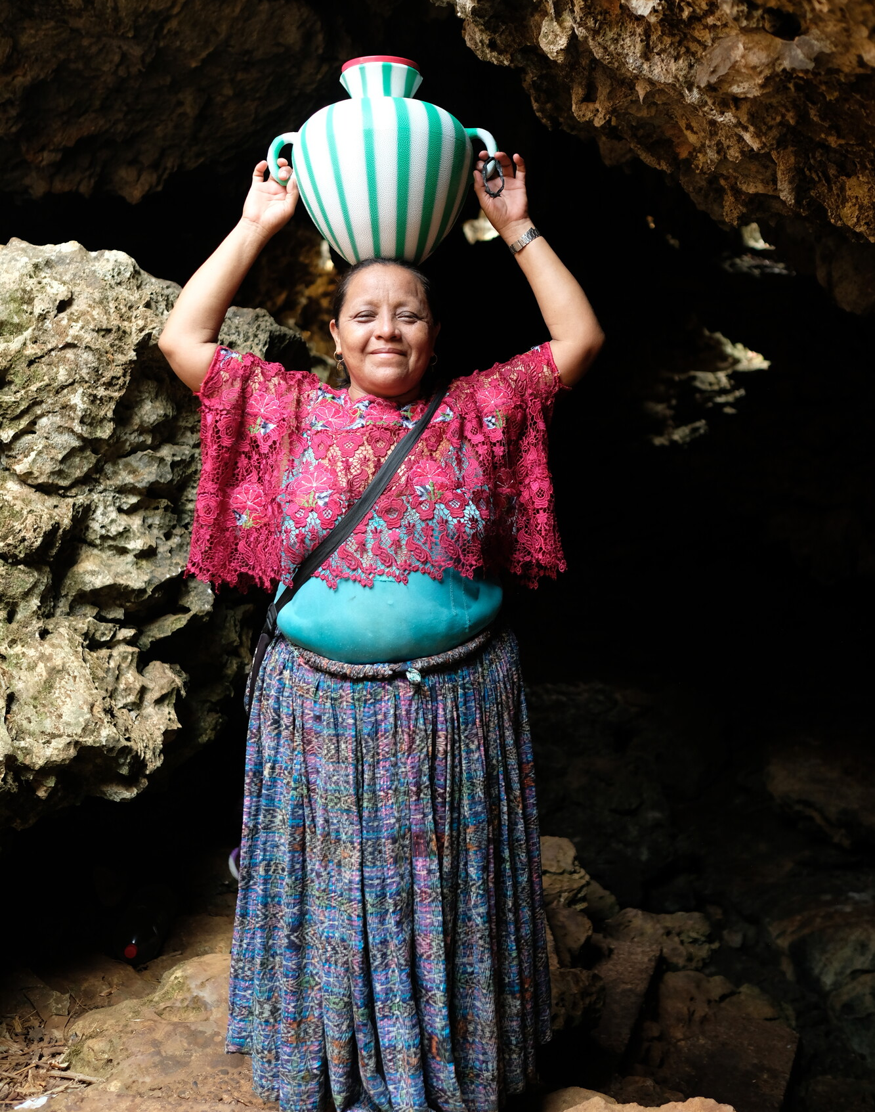
Aurelia’s story
In the Alta Verapaz region of Guatemala, 90% of people are living in poverty.
Aurelia is a farmer, community leader, a mother of eight and a beloved grandmother.
The climate crisis has hit Aurelia’s community hard. Crops are failing and water sources are drying up.
Aurelia walks for four hours each day to collect safe, clean water.
Aurelia collecting
water.

Slide 5
Opening prayer (Based on Ephesians 1)
Gracious God,
you gather all creation together in love.
As we meet today,
enlighten our hearts,
so that we may perceive the hope to which you have called us.
As your children, may we grow into your likeness,
filled with compassion and desiring justice.
Embolden us to live out our calling,
and put faith, hope and love into action.
Amen.

Slide 6
Prayer of confession
Merciful Father, you challenge us through the words of prophets.
We confess that we have failed to listen,
or pretended not to hear.
‘Let justice roll down like water,’ you tell us.
But we block the flowing streams and drain the rivers dry.
In your mercy:
Forgive us and help us.

Slide 7
Prayer of confession
Loving Lord, you came not to be served but to serve.
We confess that we have buried our talents,
and turned away from those who need our gifts.
‘Love your neighbour as yourself,’ you command us.
But we worry that such love will cost us too much.
In your mercy:
Forgive us and help us.

Slide 8
Prayer of confession
Holy Spirit, you empower us with abundant hope.
We confess that we have given in to cynicism,
and declared that the world cannot change.
When we despair, you are there to comfort us.
But we try to rely on ourselves alone.
In your mercy:
Forgive us and help us.

Slide 9
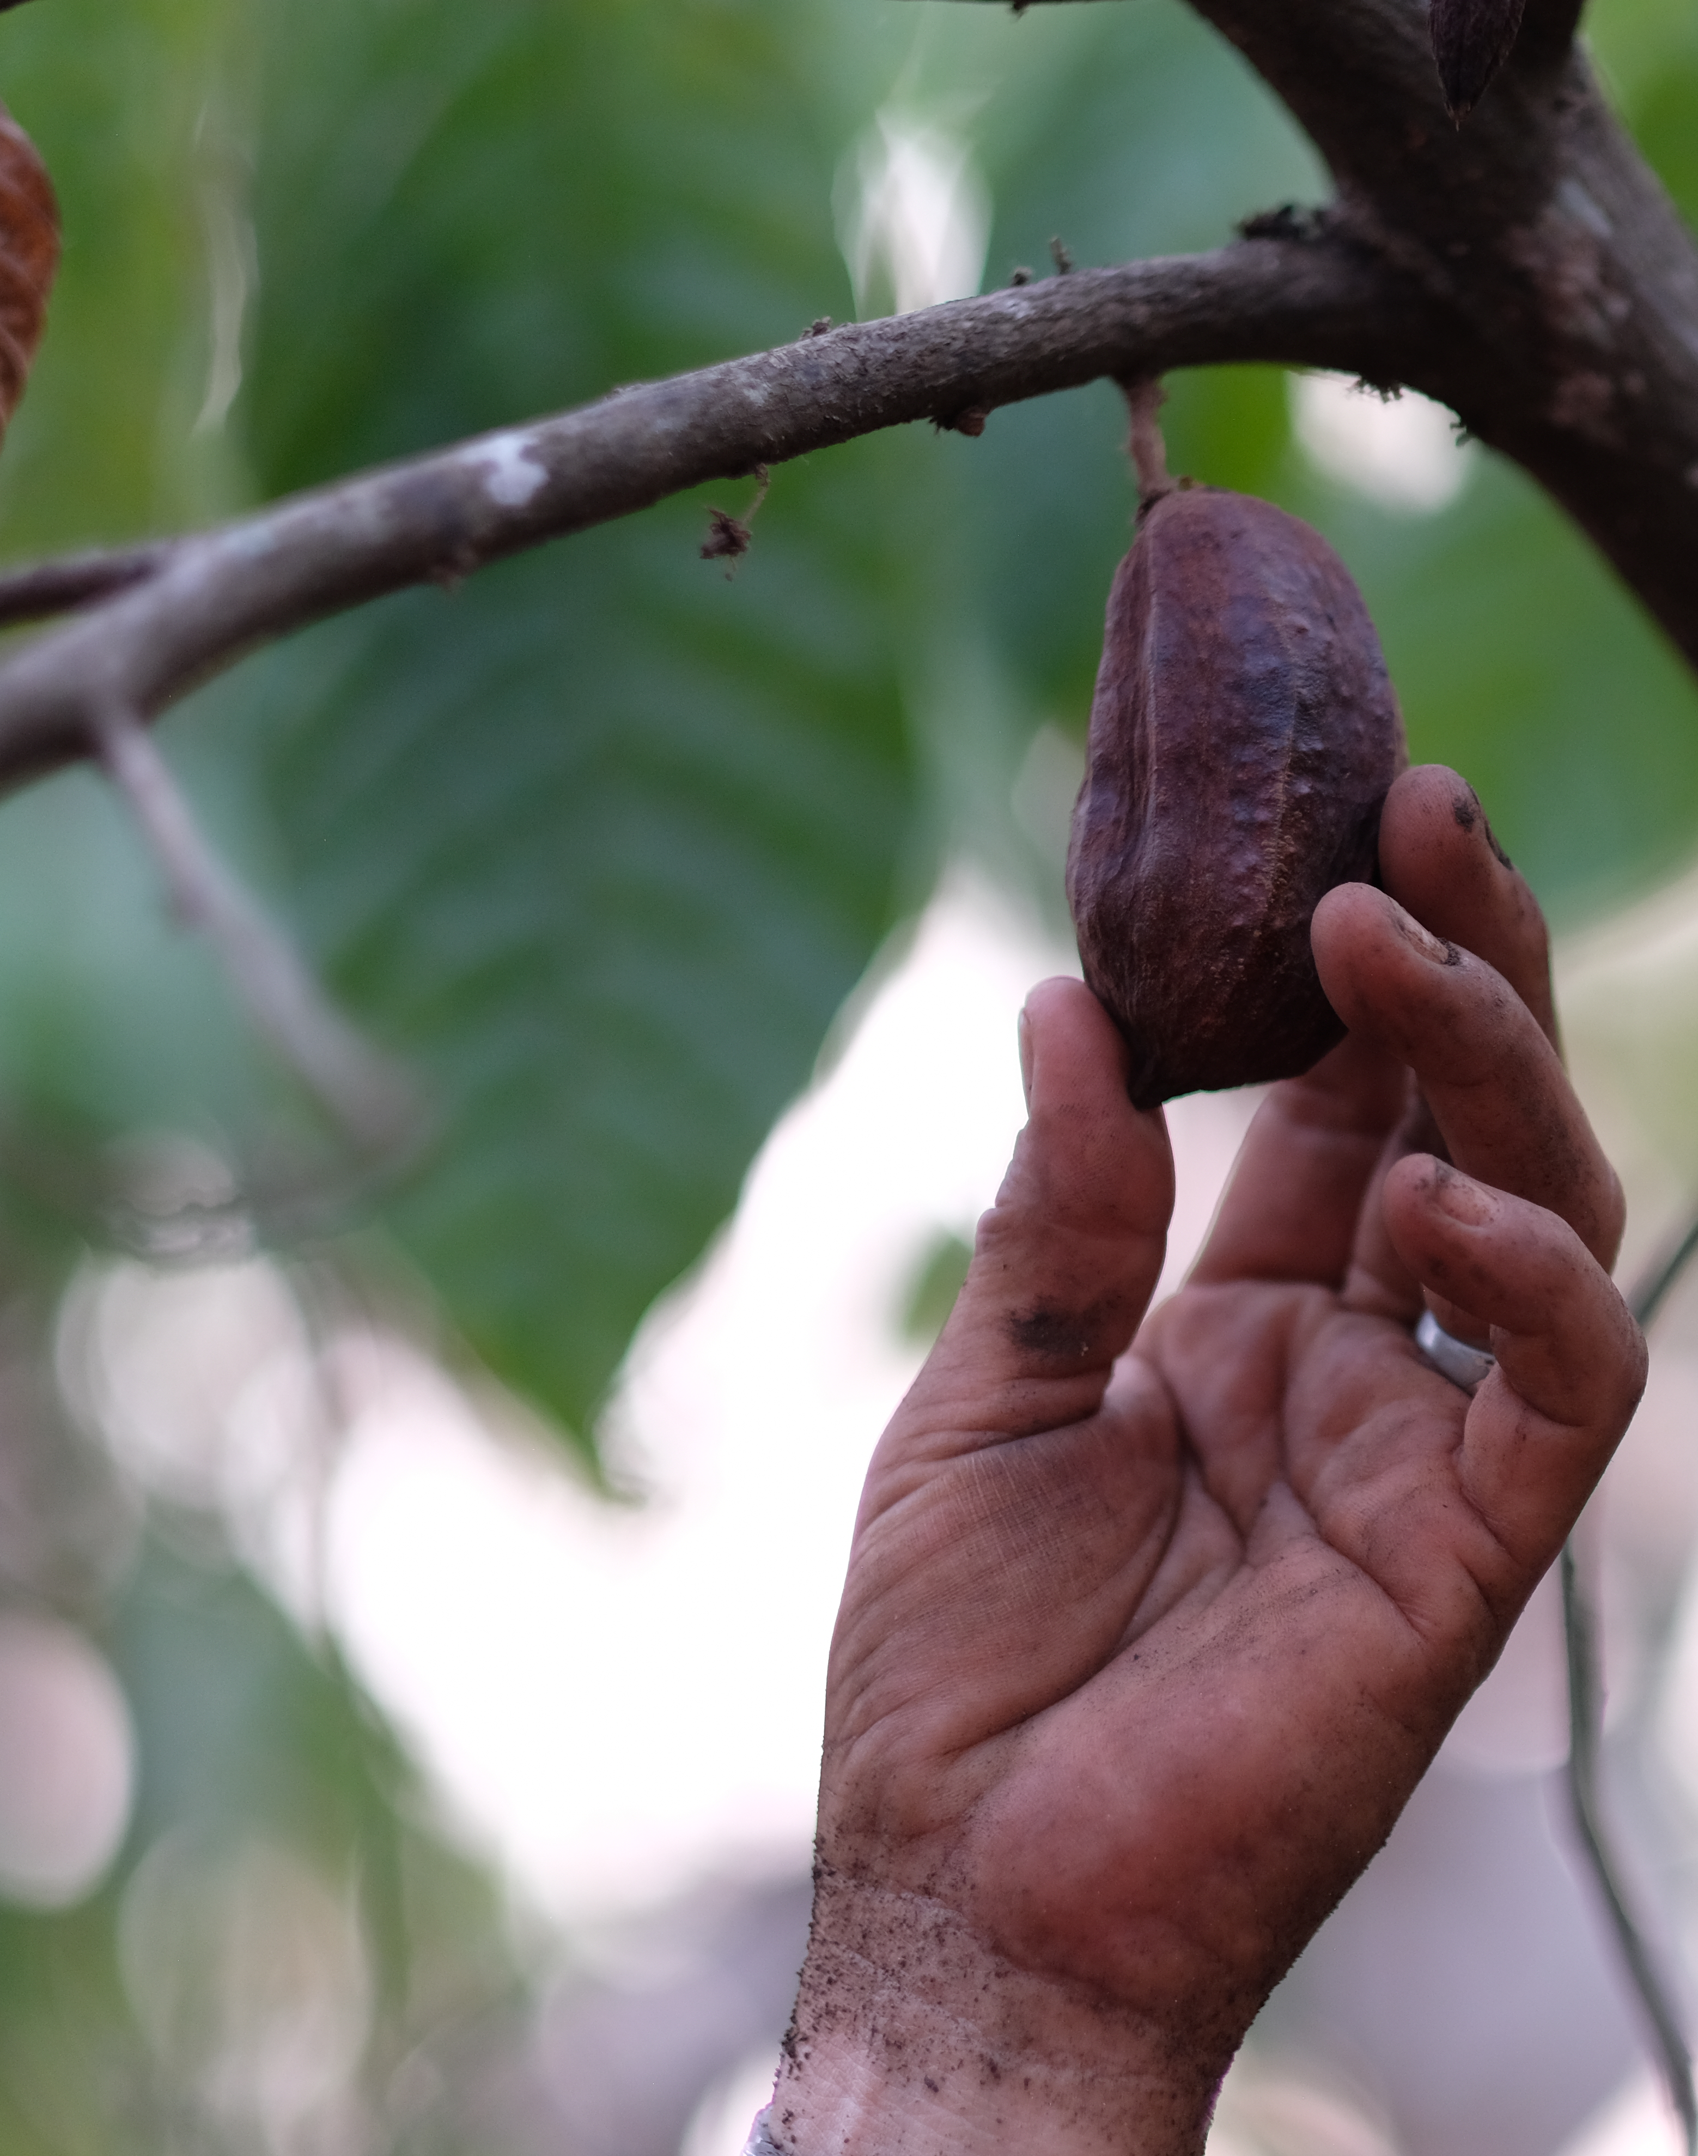
Aurelia’s story
‘Climate change has been killing our crops, and this is our food,’ Aurelia says.
‘As the plants are dying, the next thing that will die is us.’
But she isn’t giving up.
Aurelia took up the opportunity to gain new skills with Christian Aid’s partner Congcoop.
She’s combining her deep knowledge of her land with innovative farming techniques.
Aurelia holding a dead cacao pod, usually a drought resistant crop.

Slide 10
Prayer for Christian Aid Week
Lord, you are faithful to your promises.
Through the Spirit you bless us with
abounding hope.
When power seeks to silence justice,
give us the courage to raise our voice.
When an end to poverty seems far off,
renew our faith in your kingdom come on earth.
When our neighbour reaches out,
inspire us to respond with overflowing love.
In Jesus’ name,
Amen.

Slide 11
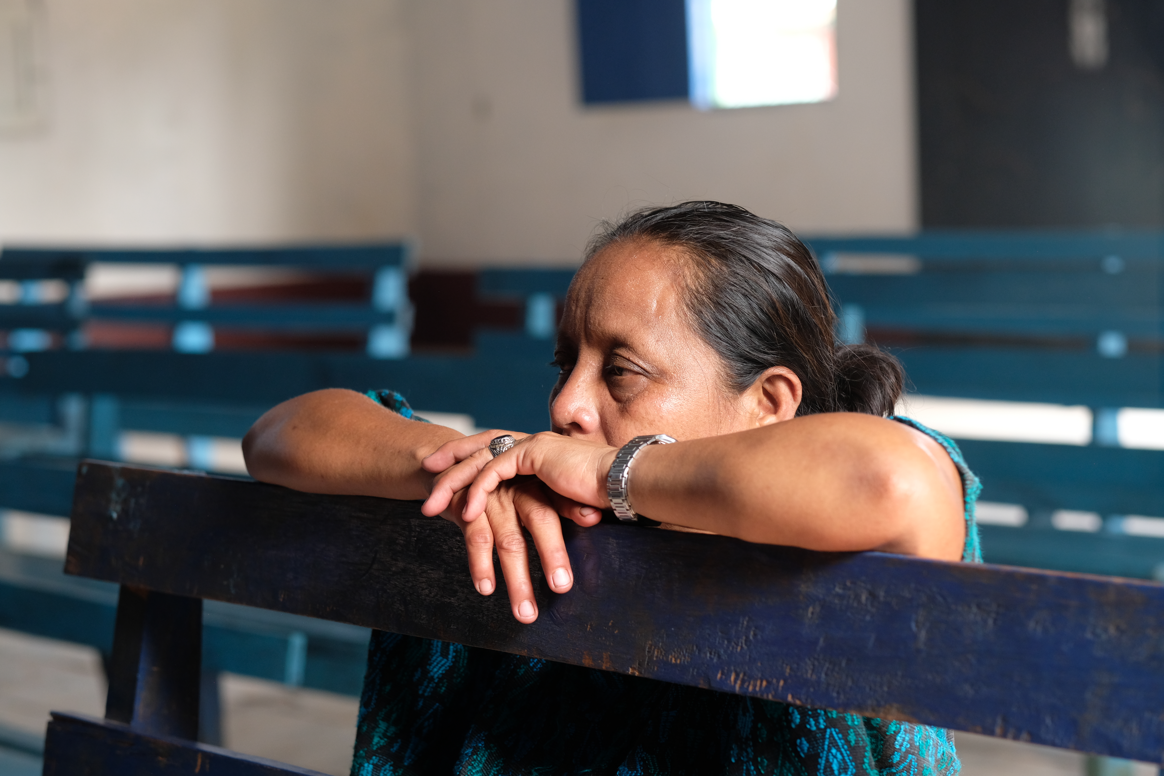
.
.
First reading
Acts 9:36-43
or
Acts 11:1-18
or
Joel 1:17-20
Aurelia praying in church.

Slide 12
Christian Aid Week film

Slide 13
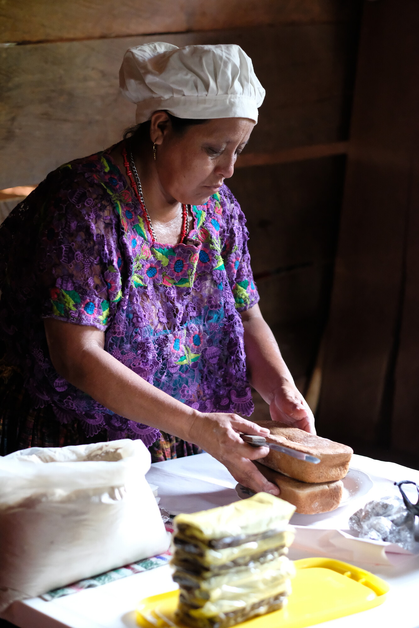
Aurelia’s story
With Congcoop’s support, Aurelia is using her cacao harvest to make chocolate products to sell at a local market.
Aurelia’s always looking to help more people in her community.
‘I really give my life to my neighbours, sharing my knowledge with them.’
‘I make cocoa products with all my heart!’ Aurelia says. ‘Perhaps that’s why they have such a good flavour!’

Slide 14
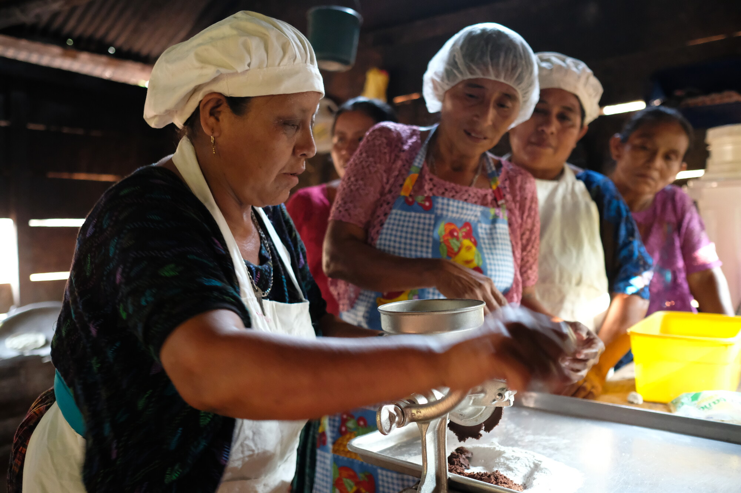
.
.
Second reading
John 10:22-30
or
John 13:31-35
or
Mark 6:30-44
Aurelia and her neighbours grinding cacao.

Slide 15
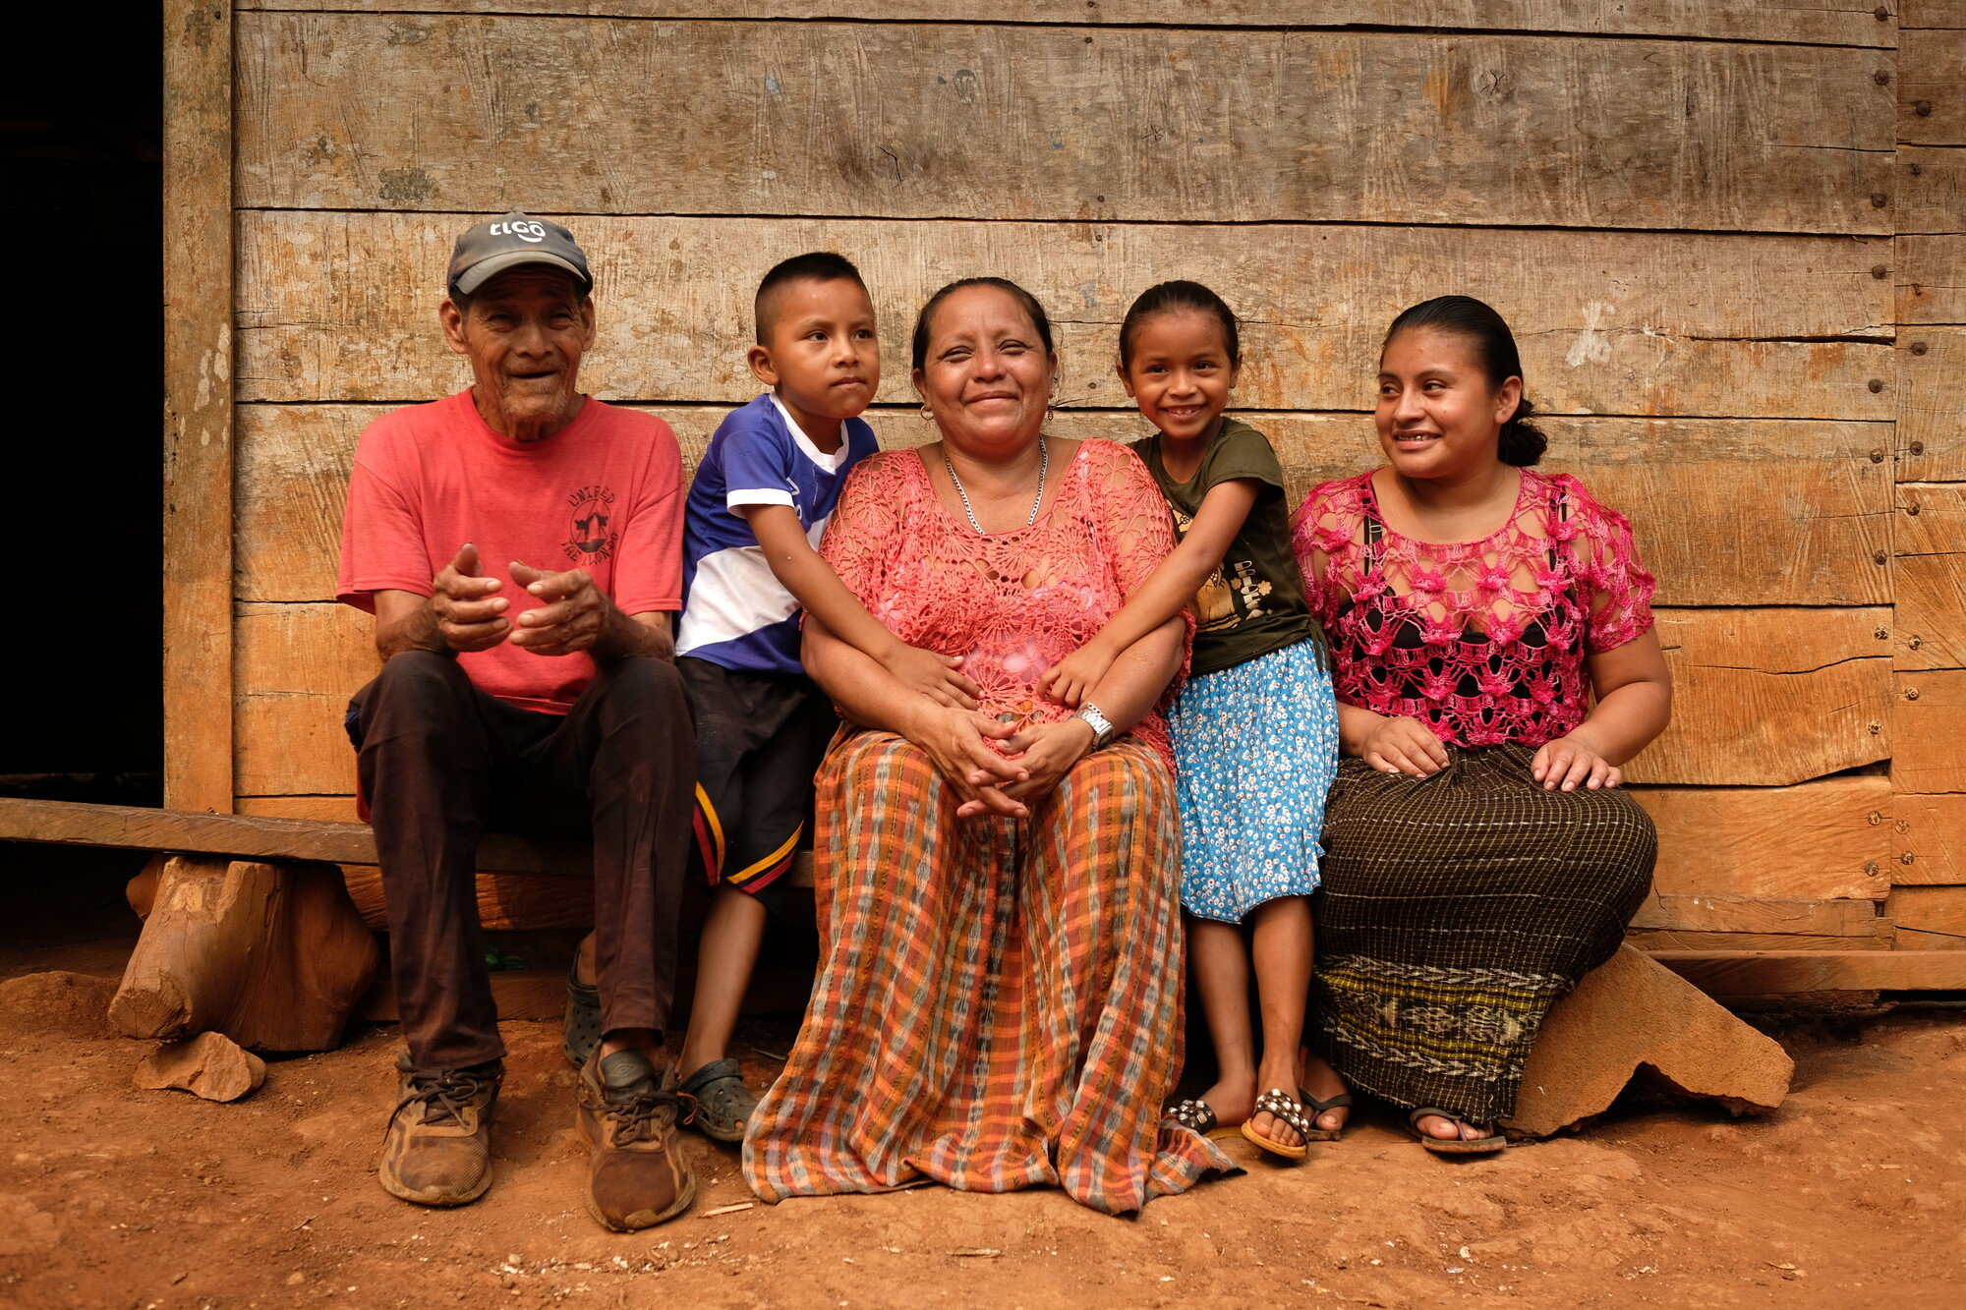
Sermon/talk
Aurelia with her father, daughter-in-law and two of her grandchildren.

Slide 16
Prayers of intercession [option 1]
The response (based on Micah 7:7) is:
We watch in hope for the Lord:
Our God will hear us.
The final response is:
We offer these prayers in Jesus’ name.
Our God will hear us.
Amen.

Slide 17
Prayers of intercession [option 2]
The people of Guatemala, particularly Indigenous communities who are often among the most marginalised groups in the country.
Christian Aid’s partner in Guatemala, Congcoop. Pray for the success of their training programmes, their staff and their work in 2025 and beyond.
Anyone living in poverty.
Households surviving on one meal a day. Parents who worry about feeding their children. Children whose growth is stunted due to malnutrition.
Farmers across the world feeling the impact of the climate crisis.

Slide 18
Prayers of intercession [option 2]
Communities who don’t have access to clean water or have to travel long distances to collect the water they need.
Large corporations running plantations in Guatemala. Pray that they take responsibility for the impact they have on the environment and Indigenous communities.
Governments and those with power. Pray that they work for justice and prioritise tackling poverty.
The work of Christian Aid and their partners. Pray for all who support this work by giving, acting and praying together.

Slide 19
Meditative prayer activity
Think of Aurelia and other women in her community walking long distances every day to gather water.
Pray for these women and for all the people of Guatemala.
End by saying these words together from La Paz de la Tierra (The Peace of the Earth): The peace of the rivers be with you, the peace of the oceans too,
deep peace falling over you.
God’s peace growing in you.

Slide 20
The Lord’s Prayer
We share the Peace
May grace and peace be yours in abundance in the knowledge of God
and of Jesus our Lord. (2 Peter 1:2)

Slide 21
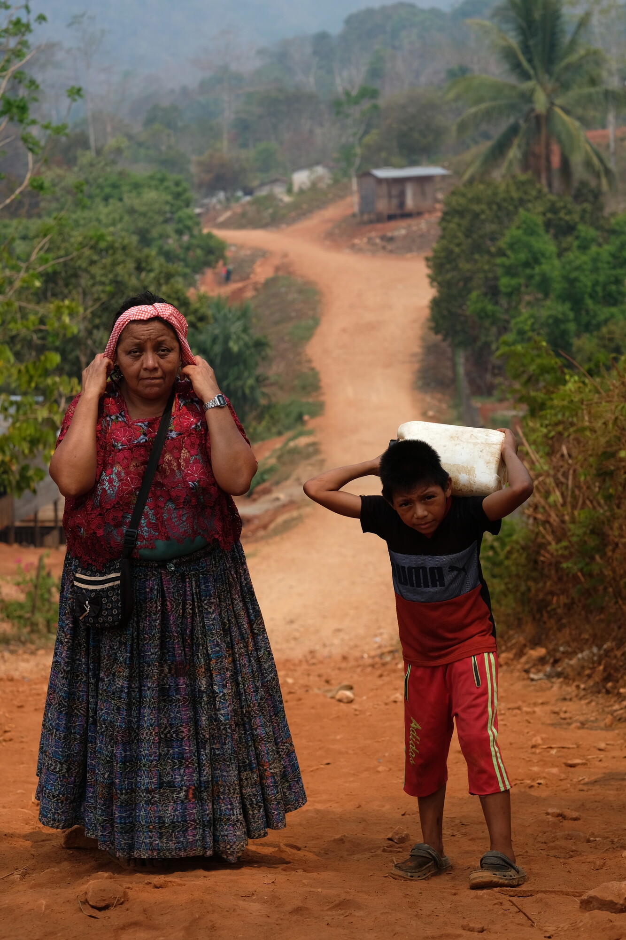
Aurelia’s story
Life for Aurelia and her community remains tough, and as the climate crisis intensifies, she fears things will get tougher.
‘This is very worrying for our kids and especially our grandkids.’
Aurelia and her grandson Edilsar return from collecting water.
‘I want to tell donors to continue supporting Christian Aid,’ Aurelia says, ‘because through Congcoop, they’ve been supporting us.’
Aline told us: ‘I don't want my children to have a painful life like mine, remembering it makes me weep.’

Slide 22
During this hymn/song, we’ll take a collection for Christian Aid
If you’d like to donate you can:
Use the red envelopes on your seat.
Donate online at caweek.org
If you can complete a Gift Aid declaration, your giving will go further.
Thank you for giving, acting and praying this Christian Aid Week.

Slide 23
Prayer of thanksgiving
God of all, you have abundantly blessed us.
As we go out from this place,
help us to do justly, love mercy and walk humbly with you.
We give thanks for the vital work of Christian Aid
and for all who support this work.
May your compassion flow through our actions and offerings.
Loving and faithful God, give us hope and send us out to serve you,
this day and every day.
Amen.

Slide 24
Blessing
God of hope,
fill us with all joy and peace in believing,
that we may abound in hope
by the power of the Holy Spirit.
Amen.

