Slide 2
Opening Responses
Sow for yourselves righteousness.
For it is time to seek the Lord.
Break up your fallow ground.
For it is time to seek the Lord.
Bring the first fruits of all your produce.
For it is time to seek the Lord.
Reap steadfast love.
For it is time to seek the Lord.
(Hosea 10.12 and Proverbs 3.9)

Slide 3
Prayer of Penitence & Lament
Let us pray to the Lord, confessing our fears and failings.
The wild beasts wait with you in the desert.
The trees clap their hands in praise of you.
The creatures of the sea fulfil your word.
But we turn away from you.
Gracious Lord, have mercy on us.
The earth is yours and all that is in it.
You declared it good.
In your hand is the life of every living thing.
But we treat the earth as our own possession.
Gracious Lord, have mercy on us.

Slide 4
Prayer of Penitence & Lament
The land mourns.
The stones cry out.
Creation groans and suffers.
But we listen only to our own interests.
Gracious Lord, have mercy on us.
Silence may be kept as those present call to mind our need for forgiveness and our grief over the climate crisis.
Gracious Lord, Creator of all,
Hear us and help us.
Amen.

Slide 5
Responses (based on Psalm 65 and Amos 5:24)
O God of our salvation; you are the hope of all the ends of the earth and of the farthest seas.
Your righteousness and justice are an ever-flowing stream.
You visit the earth and water it;
you greatly enrich it.
The river of God is full of water.
Your righteousness and justice are an ever-flowing stream.
You crown the year with your bounty.
The pastures of the wilderness overflow.
The hills gird themselves with joy.
The valleys shout and sing together.
Your righteousness and justice are an ever-flowing stream.

Slide 6
Responses (based on Psalm 65 and Amos 5:24)
Praise to you O God,
O you who answer prayer!
You forgive our transgressions.
You make the gateways of the morning and the evening shout for joy.
Your righteousness and justice are an ever-flowing stream.
O God of our salvation; you are the hope of all the ends of the earth and of the farthest seas.
Your righteousness and justice are an ever-flowing stream.
Amen.

Slide 7
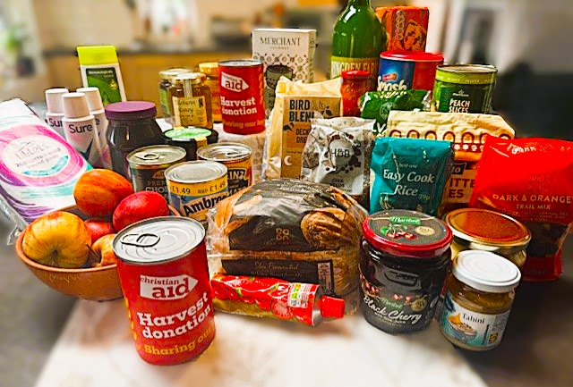
Harvest Offering

Slide 8
Praying for our neighbours
Our local neighbours and ourselves
Pray for causes close to home, such as your local foodbank and people experiencing poverty in your community.
Our global neighbours
Remembering our calling to love our neighbours as ourselves, pray for our global neighbours in places like Sierra Leone.
The earth, our home
Pray for the earth, the home of humanity and of all living creatures. Pray for those working to repair and heal the harm we have done to the natural world.
Local and global leaders
Pray for those who hold political and economic power that they would act to tackle food insecurity and the causes of the climate crisis.

Slide 9
Prayer for Hope
God of hope,
With you nothing is impossible.
Your promises endure,
Your Spirit sustains us.
Establish in us hope for your world;
Hope that moves us,
Like fire in our bones,
Like a shoot springing up from the soil,
Like an ever-flowing stream.
Nurture in us a vision for change.
Stir in us a desire for justice,
That our hope may become action,
That your will may be done.
Amen.

Slide 10
Prayer of Thanksgiving & Sending
God we thank you for the gifts that spring forth all around us,
Flowing from our fellowship,
Growing from our actions in your name.
Inspire us with your Spirit,
Encourage us to seek new ways to stand up to injustice,
And speak up for those in need.
Send us out replenished,
That we may do the work of your kingdom.
We ask this in your name, Lord.
Amen.

Slide 11
Harvest Blessing
May God our Creator bless you
And make your days fruitful.
May God our Saviour guide you,
And make your ways just.
May God our Comforter strengthen you,
And make your heart hopeful.
Amen.

Slide 13
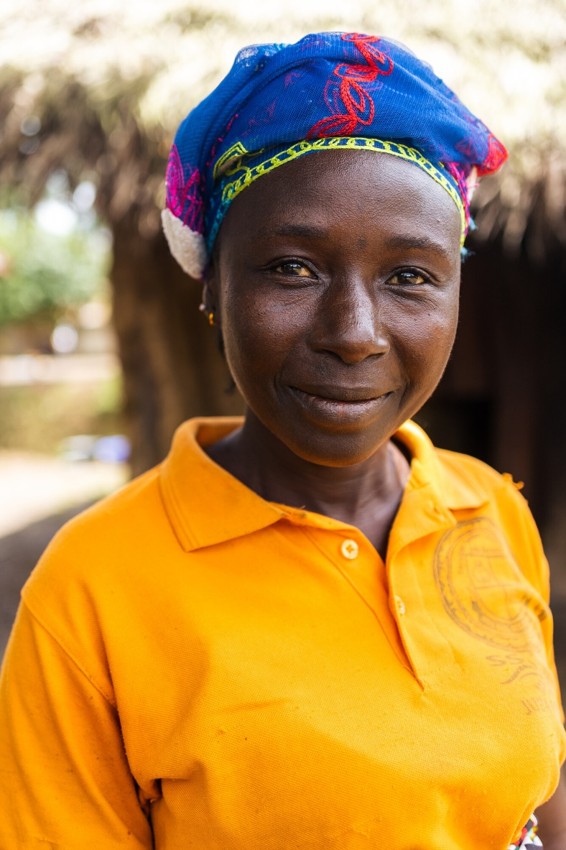
Maryama lives in Njualahun village in Sierra Leone.
She is a farmer, community leader, and a widowed mother of four children.
In recent years the climate crisis has been affecting Maryama’s crops.
Maryama in her village

Slide 14
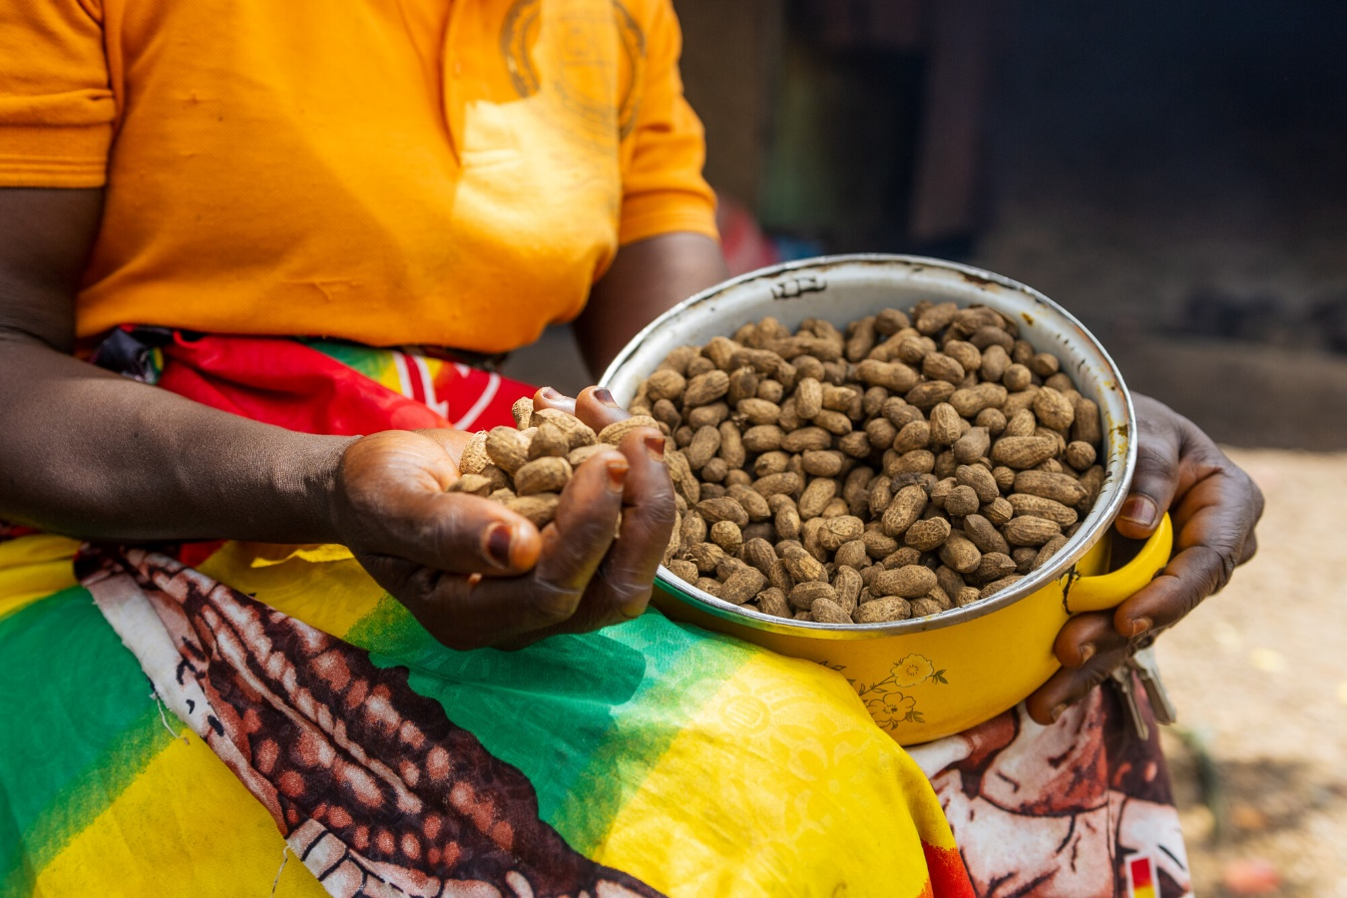
Maryama has struggled to make ends meet.
She needed to invest in her farming but her options were limited.
She took out loans that she found hard to repay.
Maryama with her groundnut harvest

Slide 15
Maryama was determined to provide for her children and fund their education.
She joined an initiative by Christian Aid’s partner WoNES to create a Village Savings and Loan Association (VSLA) in her community.
Maryama with other members of the Njaluahun village VSLA

Slide 16
Village Savings and Loan Associations empower women like Maryama to take back control of their finances, their farms and their future.
VSLAs enable their members to offer and manage low-interest loans as a collective.
Njaluahun village, Sierra Leone

Slide 17
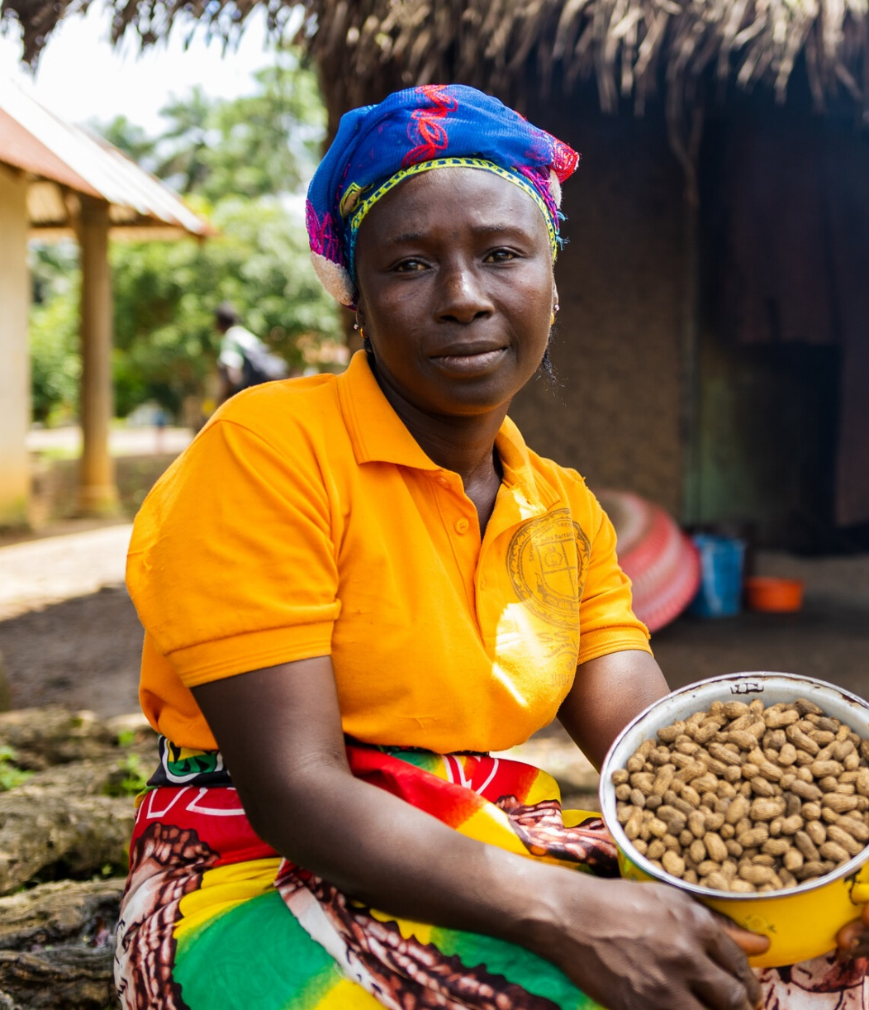
‘[The VSLA] has been a support to me because I have been able to pay my kids’ [school] fees.
It’s a blessing for us
VSLA is an empowerment for us as women. It has helped to bring us together as community members …’
Maryama with her groundnut harvest

Slide 18
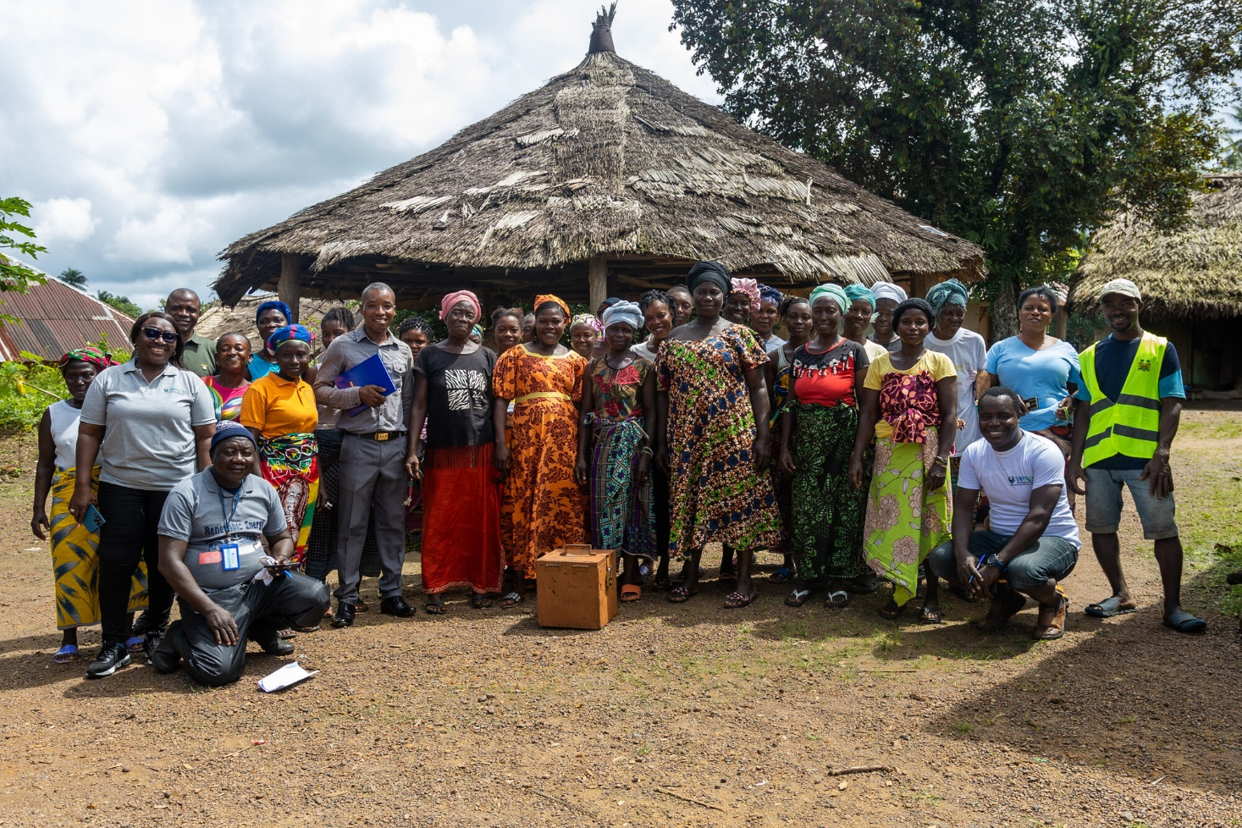
Maryama and her community still face challenges as the impact of the climate crisis grows.
But by working with WoNES and developing the VSLA, Maryama and her neighbours now have more options for the future.
Members of the Njaluajun village VSLA

Slide 19
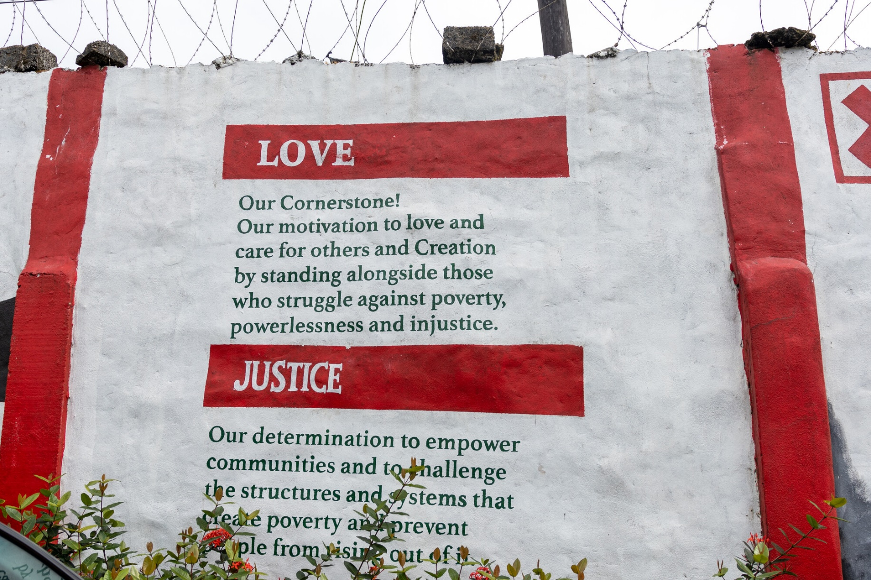
A wall mural at Christian Aid’s office in Sierra Leone
Your fundraising, support and prayers can help make Maryama’s hope a reality.

