Slide 1
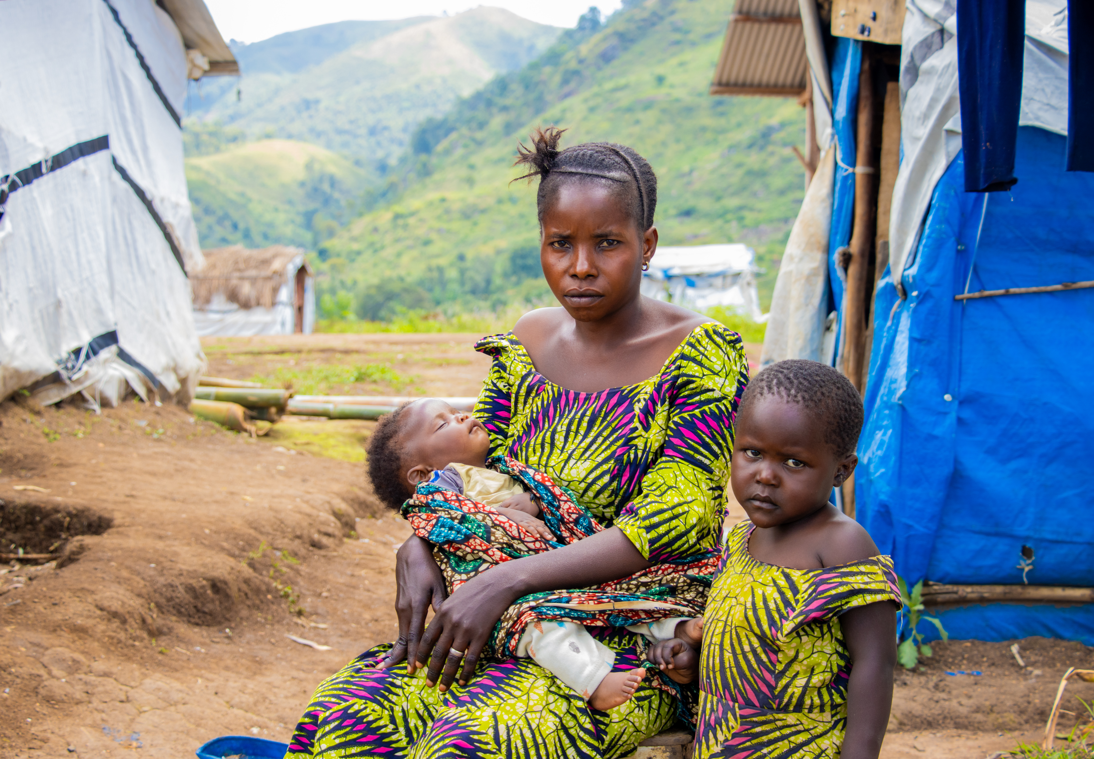

Chance with her baby Siborge and her son Pacifique outside their temporary shelter in Katashola Camp.
‘And she gave birth to her firstborn son and wrapped him in bands of cloth and laid him in a manger, because there was no place in the guest room.’
(Luke 2:7)

Slide 2
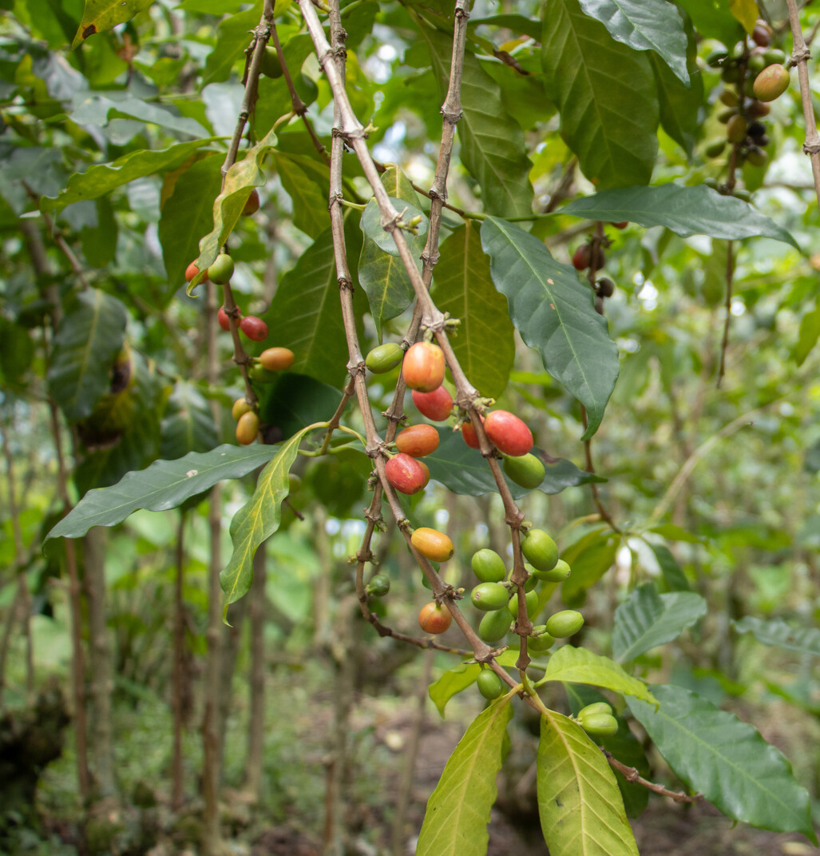

The Democratic Republic of Congo (DRC) has vast amounts of natural resources.
Over centuries these resources have been exploited by wealthier countries.
It’s likely your
mobile phone includes materials from the DRC.
Coffee beans growing in the DRC

Slide 3

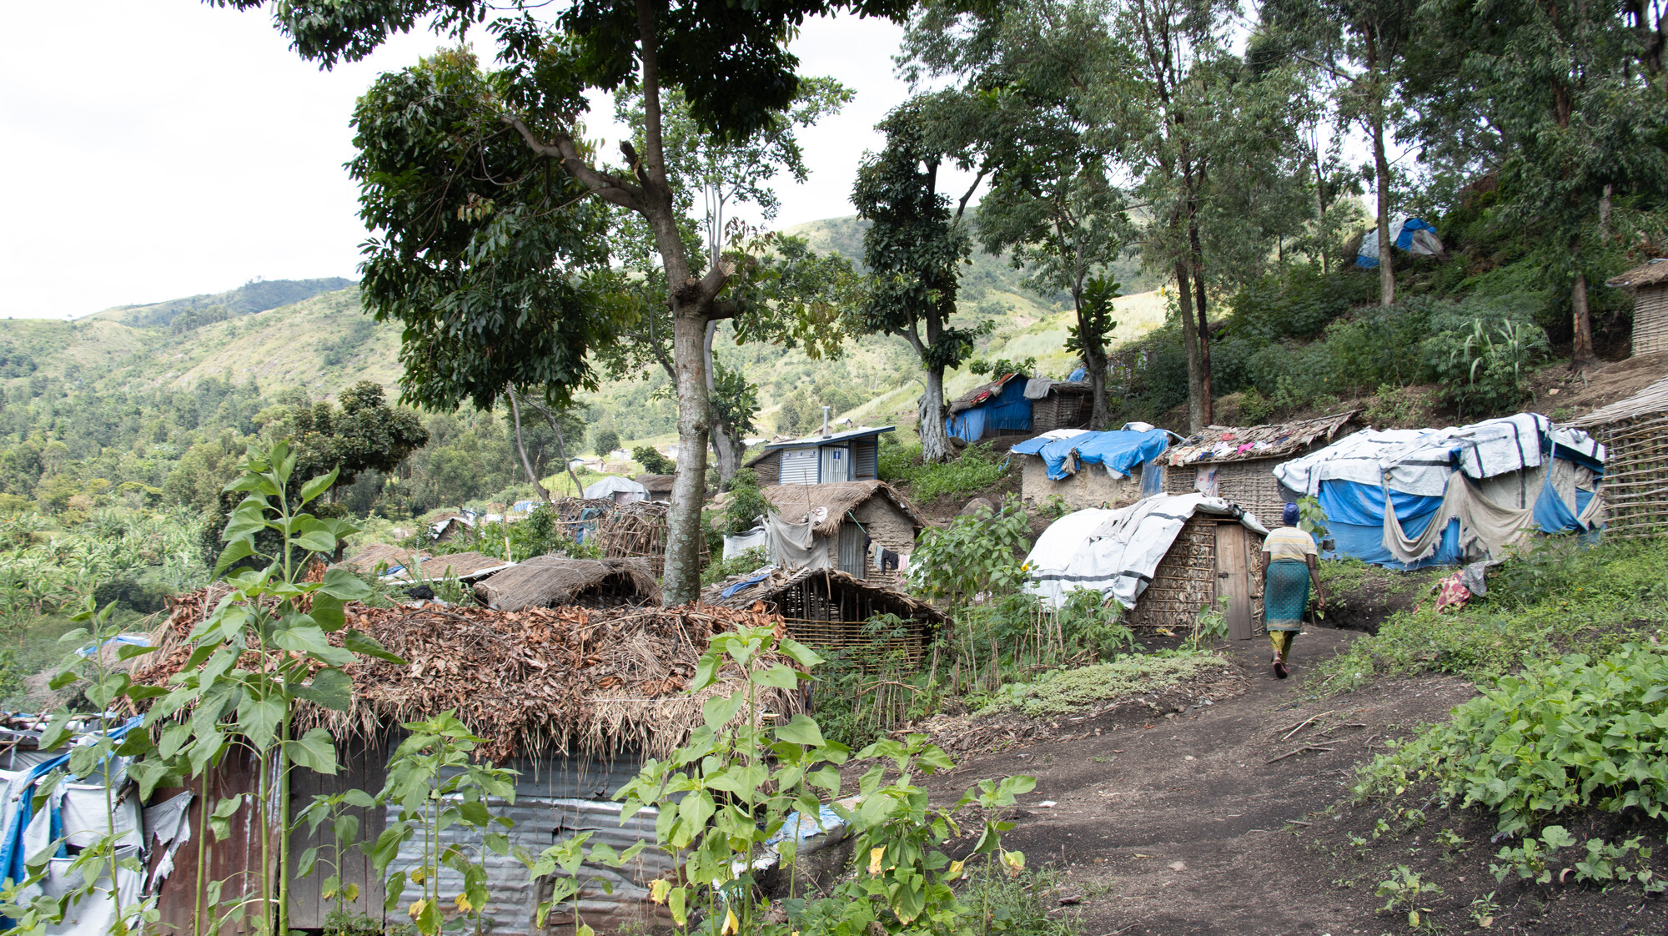

Exploitation and conflict mean millions of people in the DRC
live in extreme poverty.
70% of people lived on £1.50
a day or less in 2024.
A camp for displaced people in South Kivu in the DRC.

Slide 4
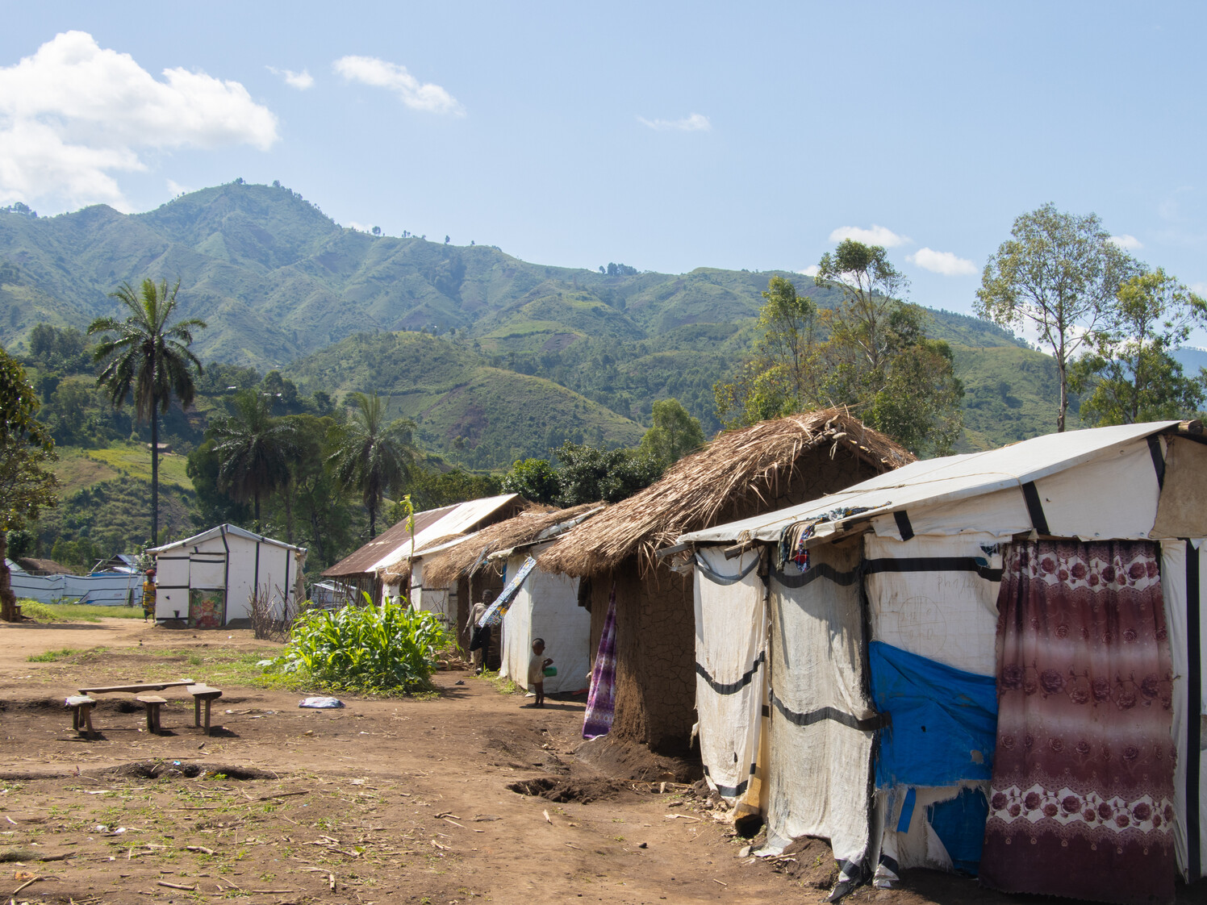

Katashola Camp for displaced people in the DRC.
Today the DRC faces one of the largest humanitarian crises of our time.
Conflict between armed groups and government forces is forcing families to flee their homes.

Slide 5
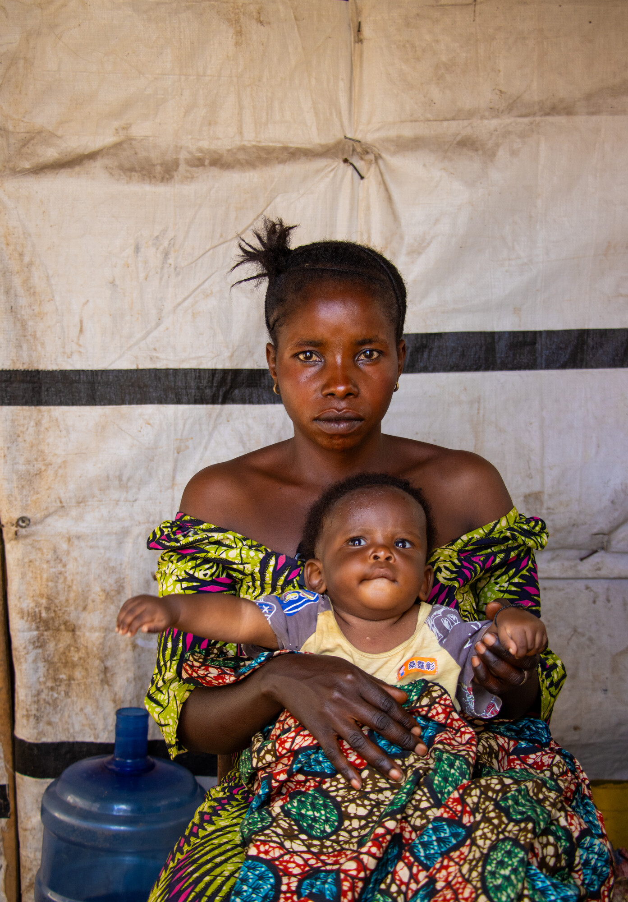
Chance has eight children, including baby Siborge.
She was forced to run from her home to escape armed conflict, shortly after giving birth.
She was separated from her husband and does not know where he is.
Chance with baby Siborge in Katashola camp.

Slide 6
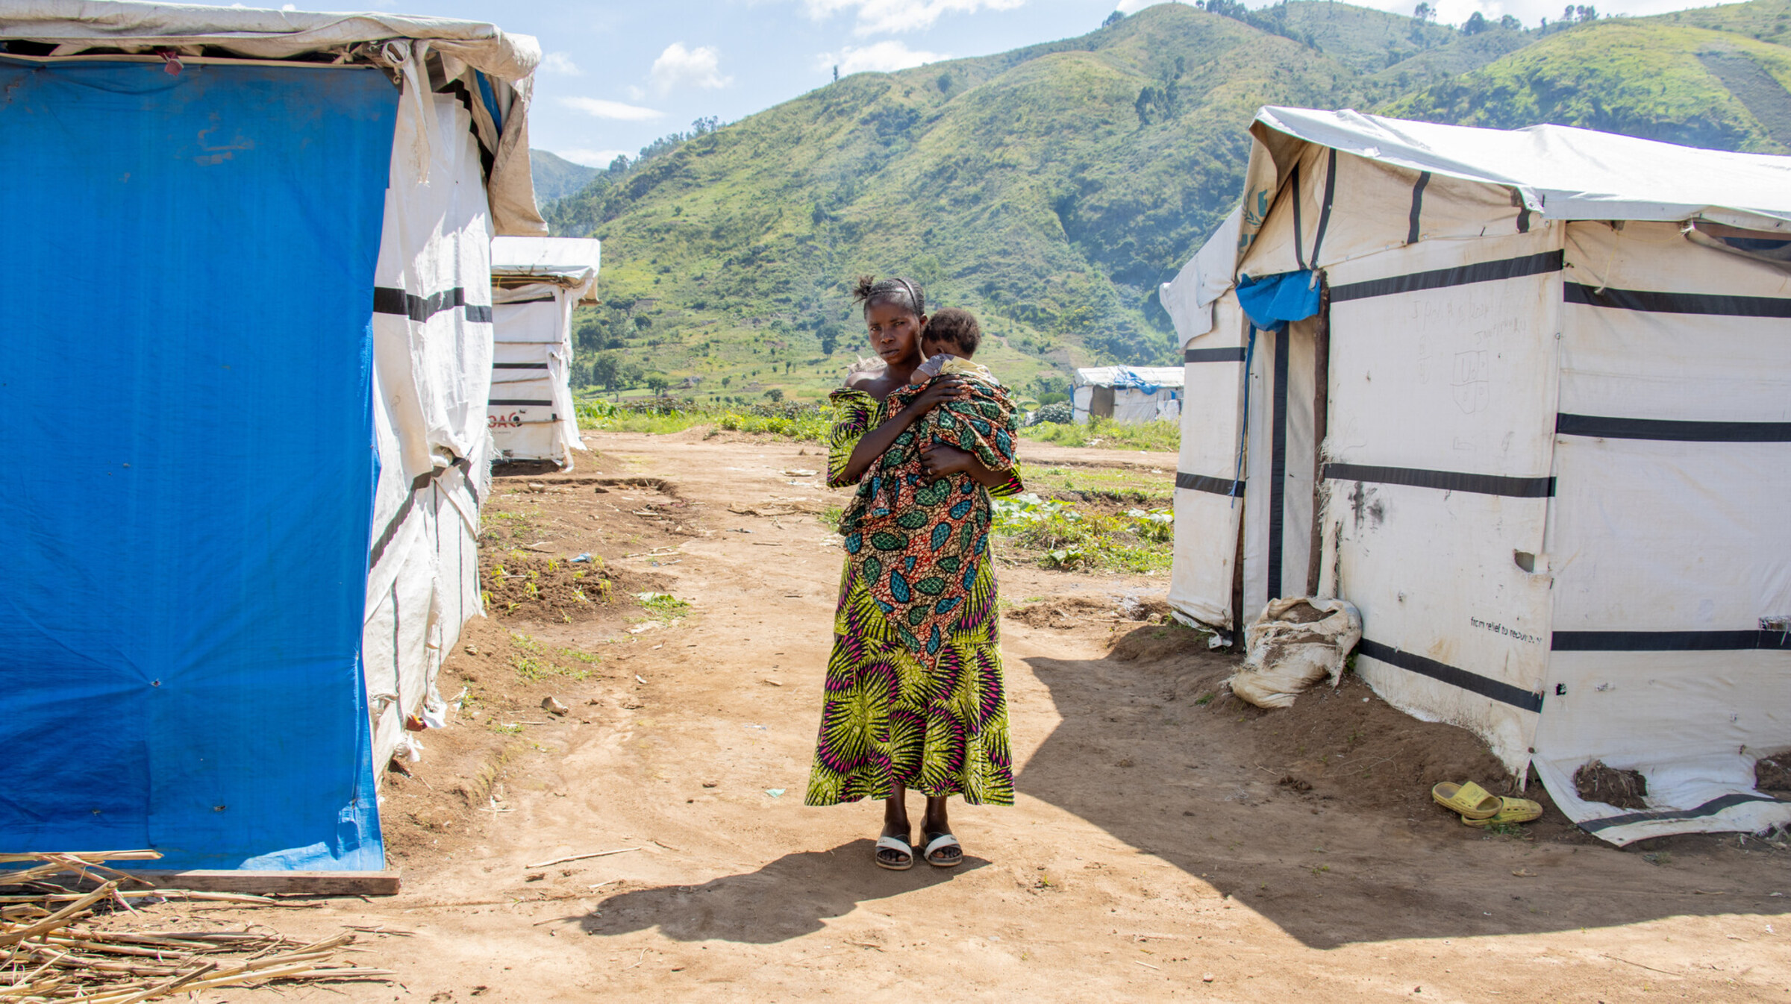
Here in the camp, people need food, clothes … we have nothing like blankets and mattresses. The life I am living with this baby is very painful. Even finding soap to wash him and his clothes is so difficult.
- Chance
Chance reached the relative safety of Katashola camp for displaced people.
But Chance and her children don’t have the essentials they need and are at risk of malnutrition.

Slide 7



Working with our trusted partners ECC-MERU, Christian Aid offers financial assistance to displaced people like Chance and her children.
Cash grants enable parents to buy food, bedding and blankets for their children.

Slide 8
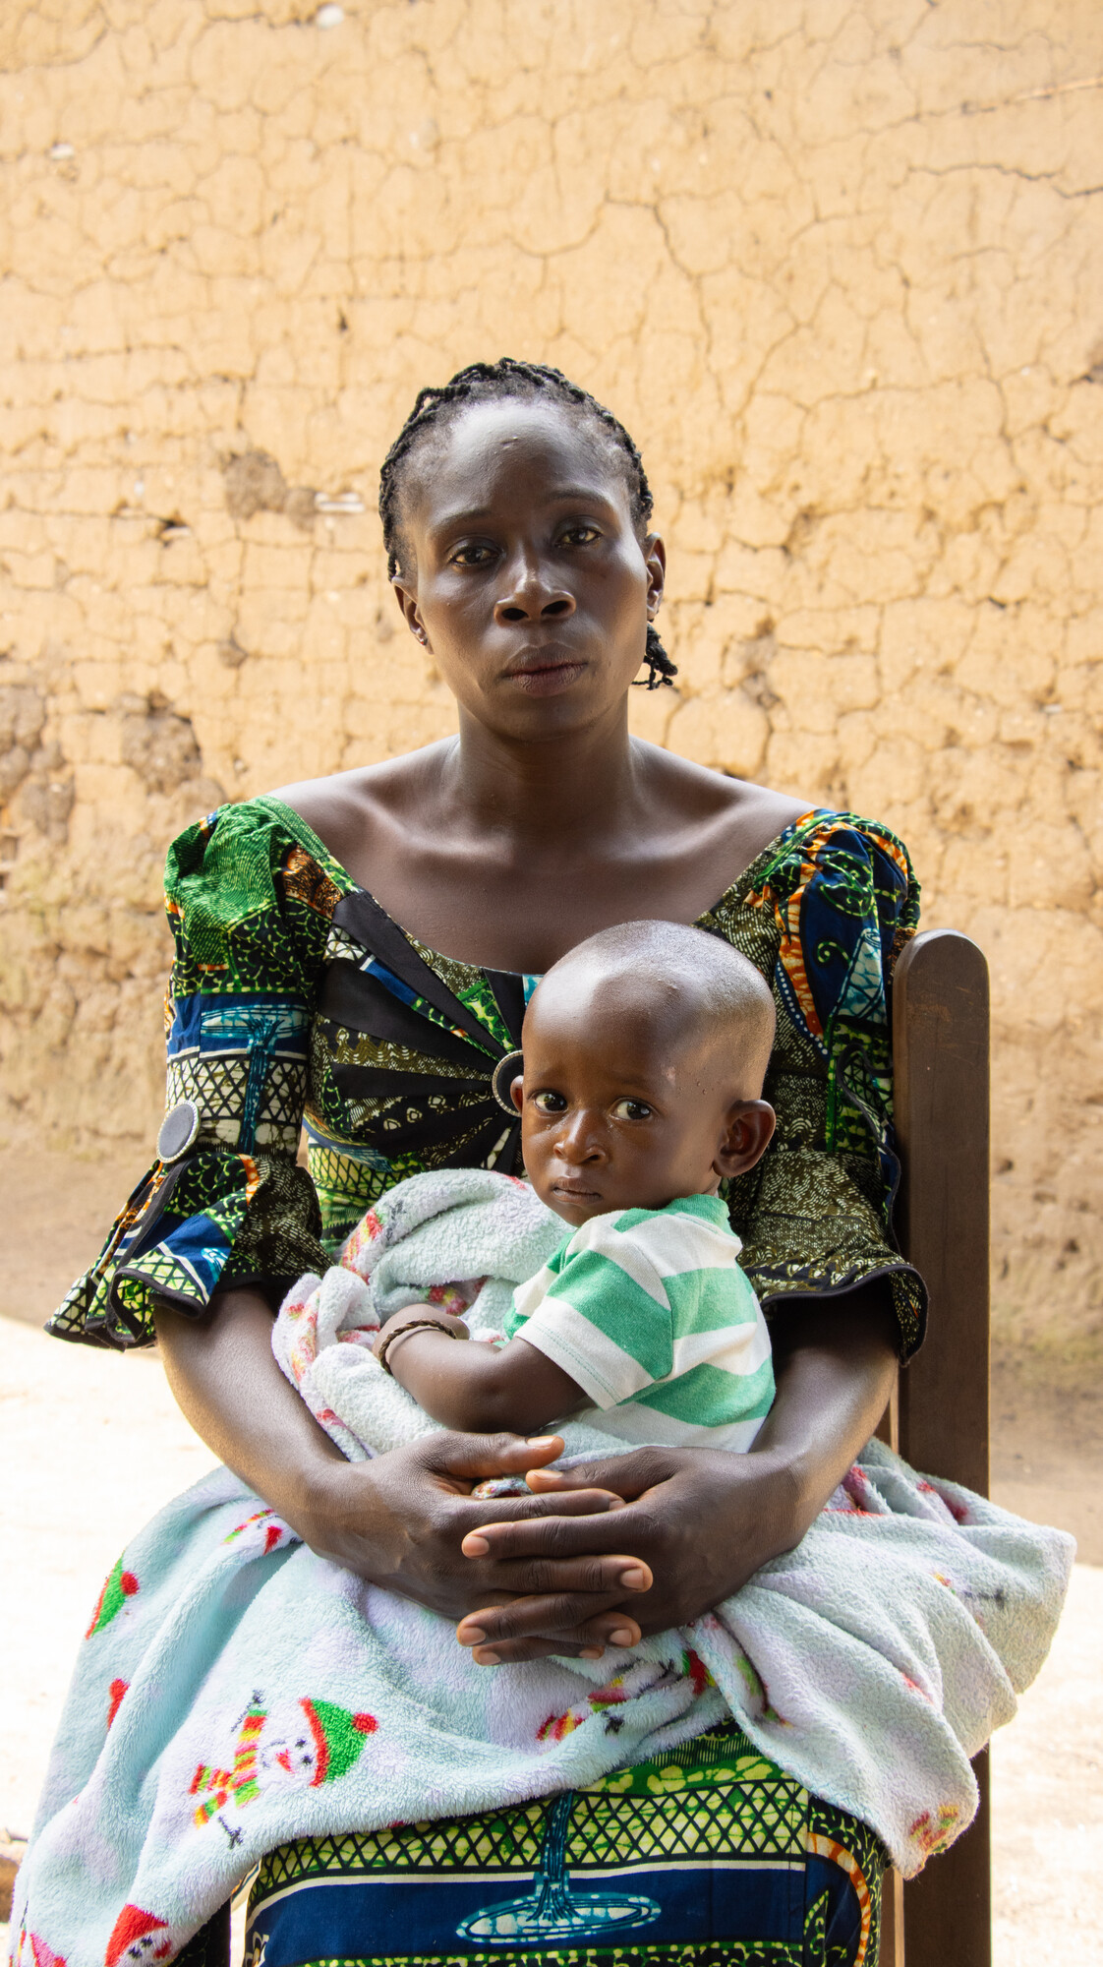

Like Chance, Joyce was forced to flee with her young family.
Soldiers came to Joyce’s village when her baby Emiliana was just two months old.
Joyce with her baby Emiliana.
Emiliana just clung to my chest. I was scared and thinking: Will I die? Will
my children die too?
- Joyce

Slide 9
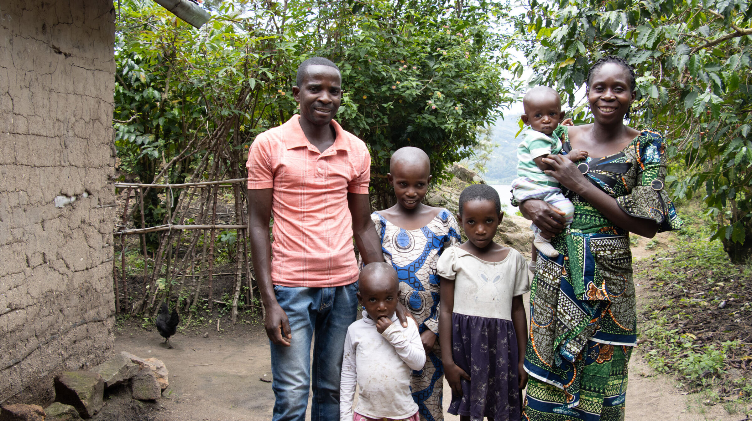
Joyce’s family spent time enduring hunger and thirst in a displacement camp.
They have been able to return home but the trauma has stayed with them.
Emiliana’s whole five months of life have been very stressful.
She doesn’t even get enough time to play with me due to my fear.
- Joyce
Joyce with her husband Michel and their children.

Slide 10
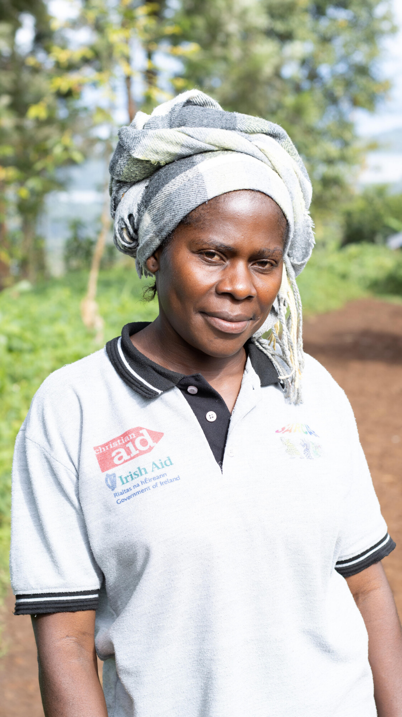
Christian Aid’s partner SARCAF assists women in the DRC with the care they need after experiencing violence.
Wilhermine is a community-based psychological support worker with SARCAF.
Psychological support worker Wilhermine.
If I see women who are struggling, I let them know that we can talk and how I can help them through their thoughts.
- Wilhermine

Slide 11
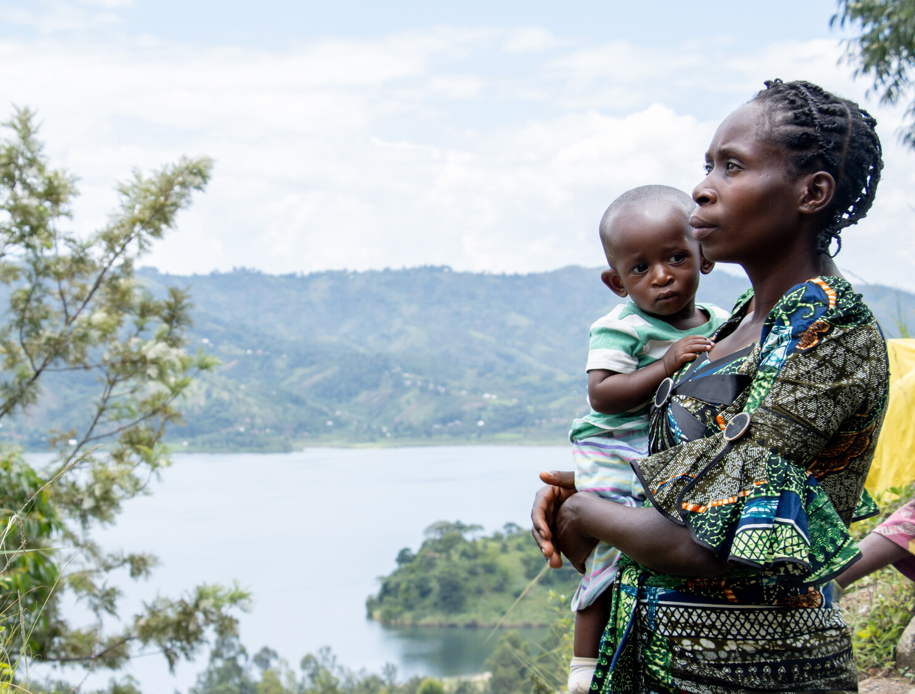



This Christmas families who’ve escaped conflict urgently need your support to survive.
Please join us in praying, acting
and fundraising.
Joyce tells her baby Emiliana: ‘You will live like God had planned.’

Slide 12


A Prayer for Advent and Christmas 2025
Prince of Peace, as a baby you had no safe place to rest.
We pray to you today for all children forced to flee violence.
We lift to you families and communities enduring instability and fear.
In this season of hopeful expectation, we pray for those who do not know what tomorrow will bring.
Challenge us, Lord, to live out your call to seek peace and pursue it.
Heal our divisions and inspire us to act with justice and love.
Amen.

Slide 13


