Slide 1

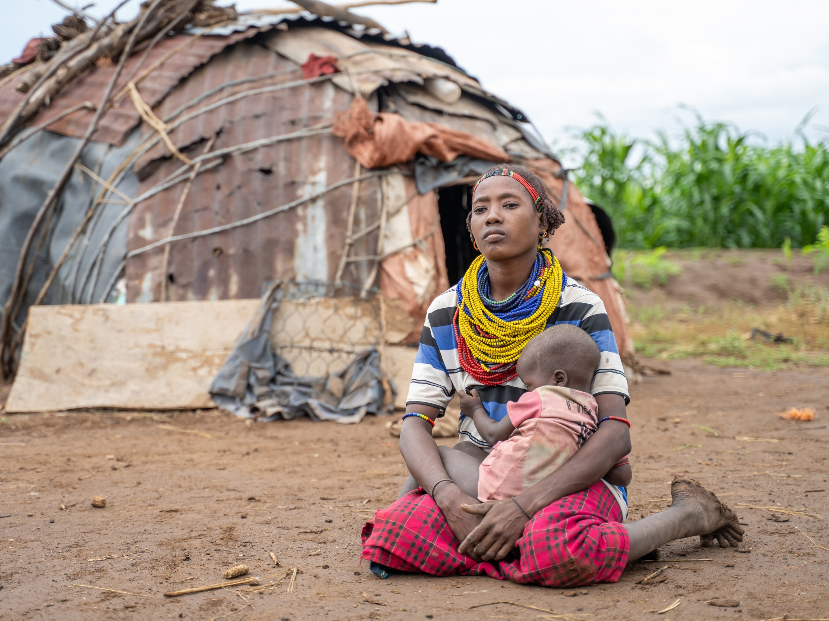

Notes:
As we celebrate the birth of Jesus, we're reminded that God is with people facing uncertainty and hardship. Today, we're going to hear the story of Donnay, a mother in southern Ethiopia whose family was forced to flee devastating floods, and how she is rebuilding her life and livelihood.
As we listen to her story, let's consider what Christmas hope looks like for families facing challenges around the world.

Slide 2
Opening Responses
A child has been born for us.
How will we welcome him?
He is named Wonderful Counsellor, Mighty God, Everlasting Father, Prince of Peace.
How will we welcome him?
A son has been given to us. He brings justice and righteousness.
How will we welcome him?
In our neighbour we see his face.
How will we welcome him?
(Based on Isaiah 9)

Slide 3
Gathering Prayer
Jesus, Son of the Living God,
Your birth brought together shepherds and kings.
Gather us today as one body,
united in hope, joy and peace.
Light of all people,
You were born to bring justice and mercy.
Illumine our path
and lead us into the ways of truth and compassion.
Holy child, laid in a manger,
You knew the meaning of poverty.
Make us ready to love and serve you
through loving service to one another.
Amen.

Slide 4
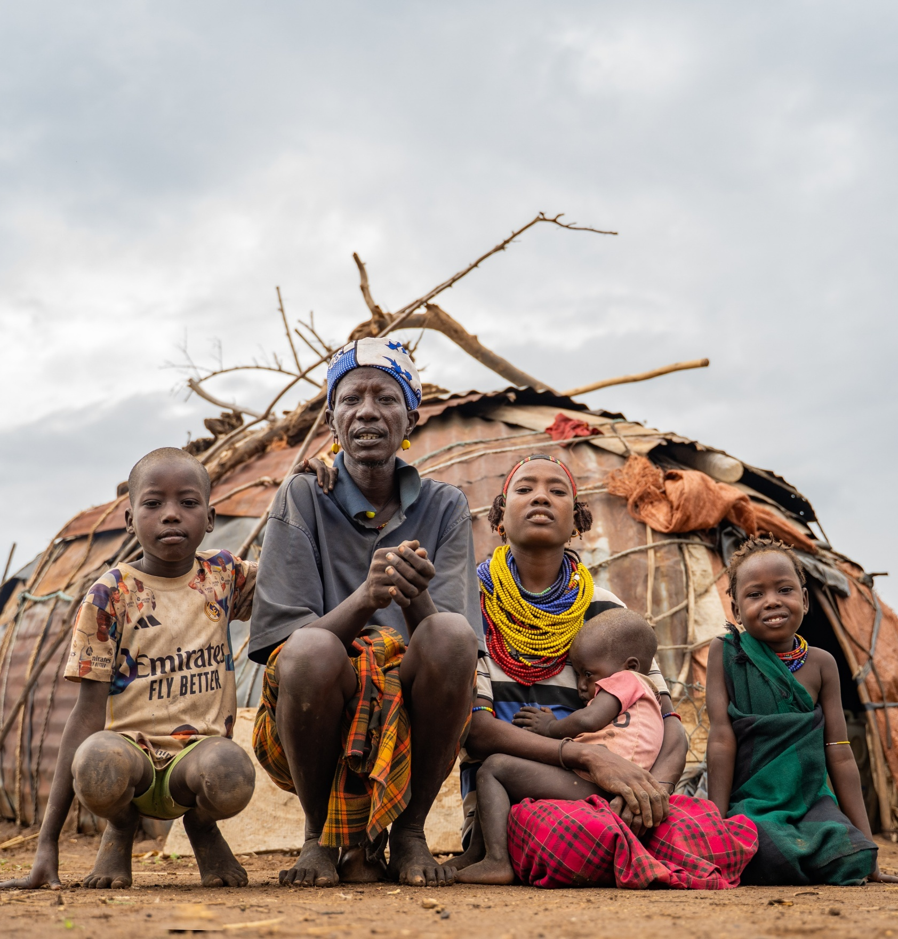
Donnay’s Story
Donnay lives in southern Ethiopia with her husband and children.
When devastating floods swept through her community, her family fled in the middle of the night.
Notes:
Donnay lives in southern Ethiopia with her husband and children. Like many people in her community, her family depended on farming to provide food and an income.
Donnay's community is in the Dasenech region. For generations, families have farmed using a method known as flood-retreat cultivation. When the River Omo flooded at the expected time each year, the water left moisture and nutrients behind, creating fertile land for crops to grow.

Slide 5

‘The flood was sudden and devastating.
We escaped with our children without any belongings.’
Donnay, Ethiopia
Notes:
In recent years, flooding has become much less predictable. Instead of supporting farming, severe floods have damaged homes, land and livelihoods. One devastating flood forced Donnay and her family to flee for safety.
Donnay describes having to escape with her children and husband. Their home, food, crops and cows were washed away in one night.

Slide 6

The flood changed everything.
Donnay's family depended on farming and livestock to feed their children and earn an income.
When the floods swept through their village, they lost their home, farmland and most of their livestock.
Without crops or animals, hunger quickly became part of daily life.
When the family arrived in Old Omo village, they were hungry, homeless and empty-handed.

Slide 7
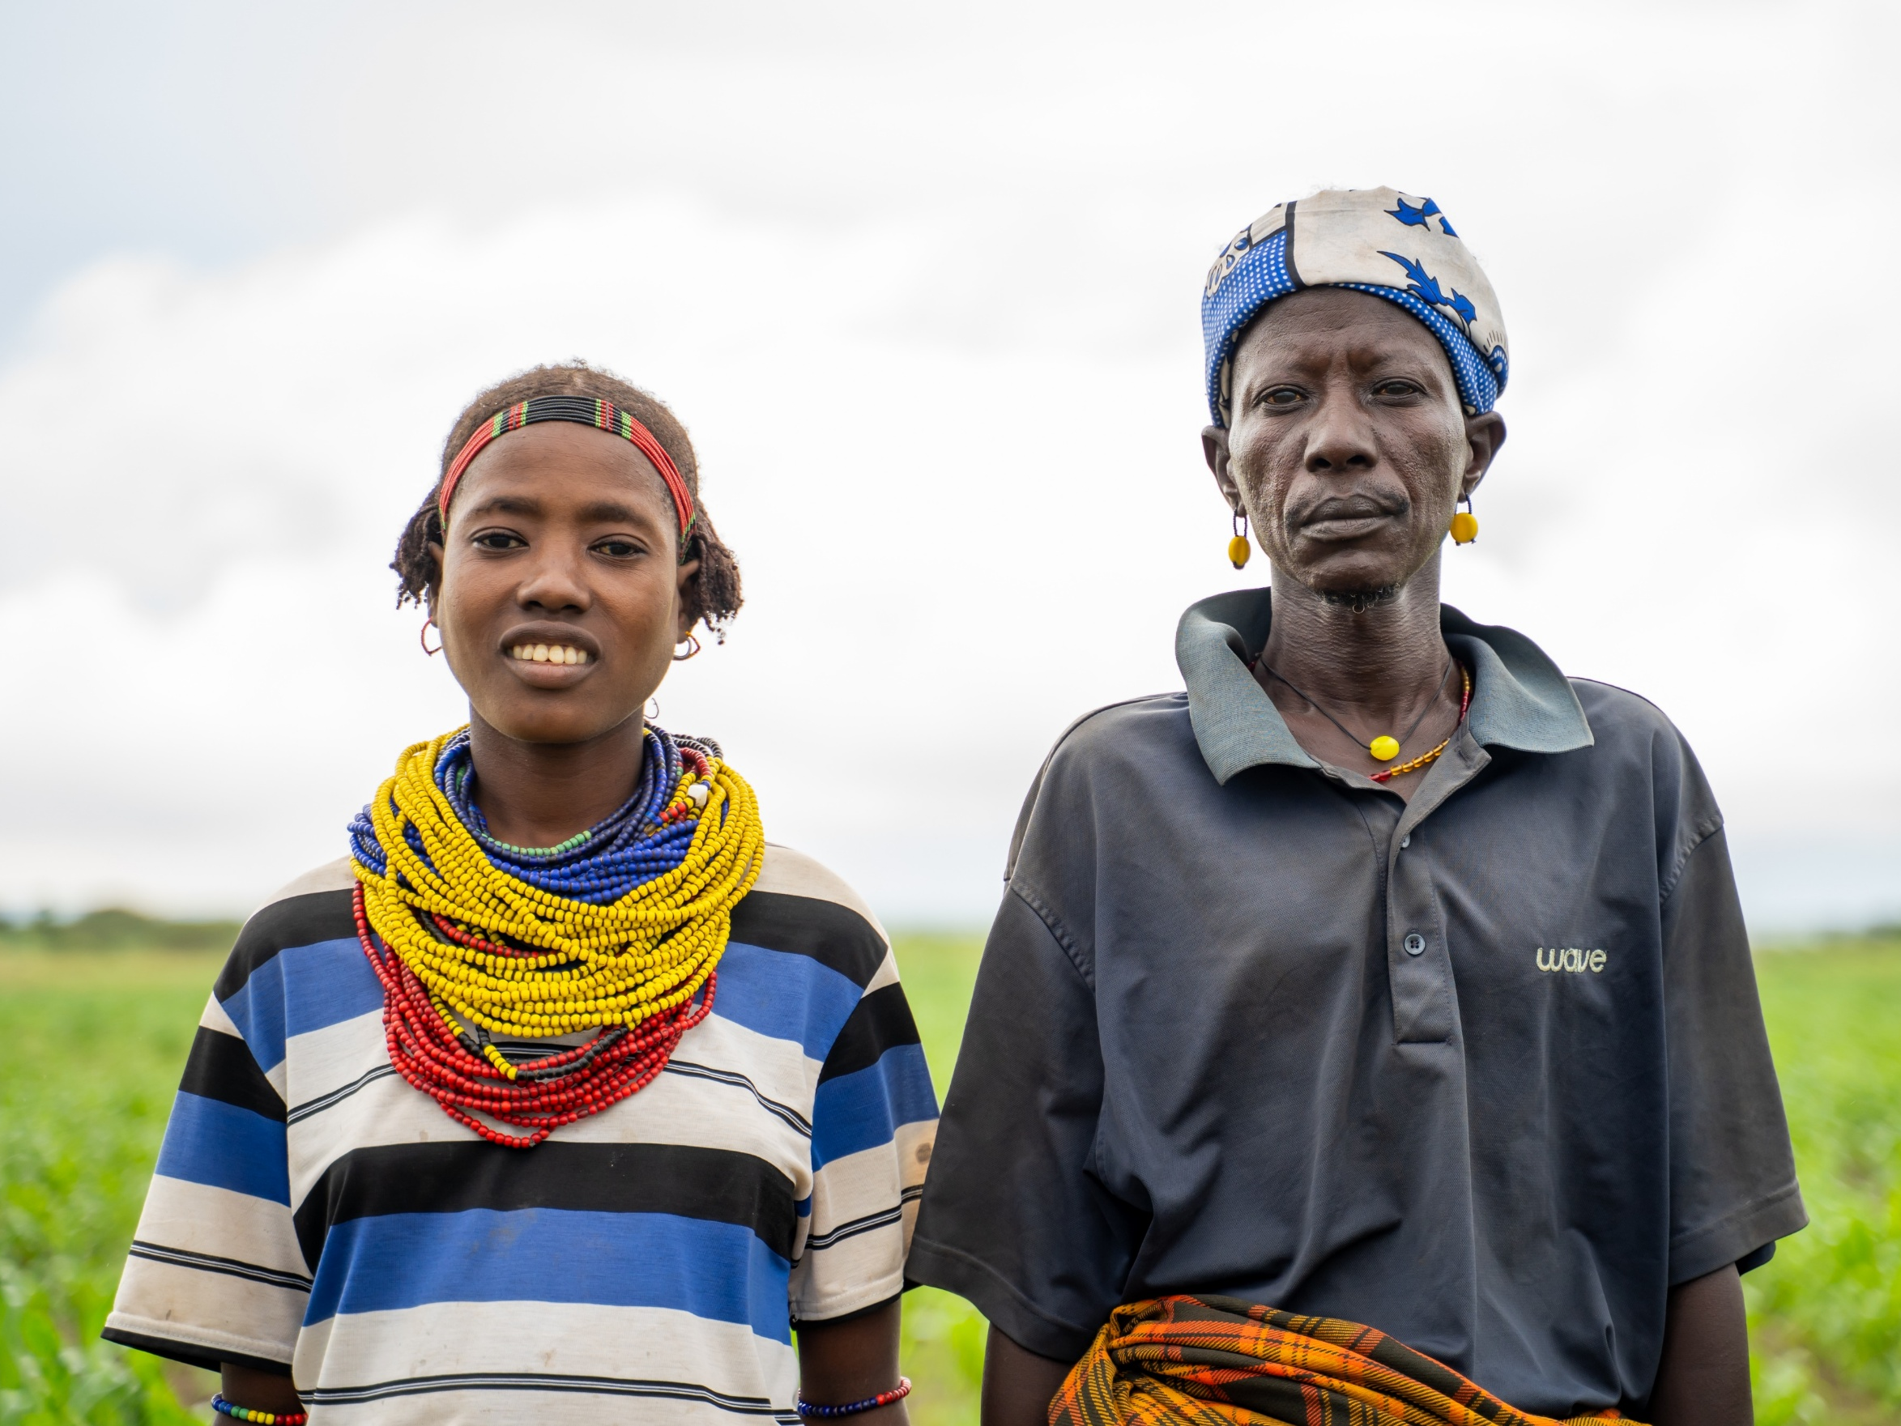
Starting again
In Old Omo, Donnay and Gnipey received seeds, tools and agricultural training to begin farming again.
Together with support from Agri Service Ethiopia, they started growing maize, tomatoes, onions, beans and sorghum.
Notes:
After fleeing the floods, Donnay, Gnipey and their children settled in Old Omo village, where they began rebuilding their lives.
Christian Aid's local partner, Agri Service Ethiopia, provided seeds, tools and agricultural training to help families begin farming again and adapt to unpredictable floods.

Slide 8
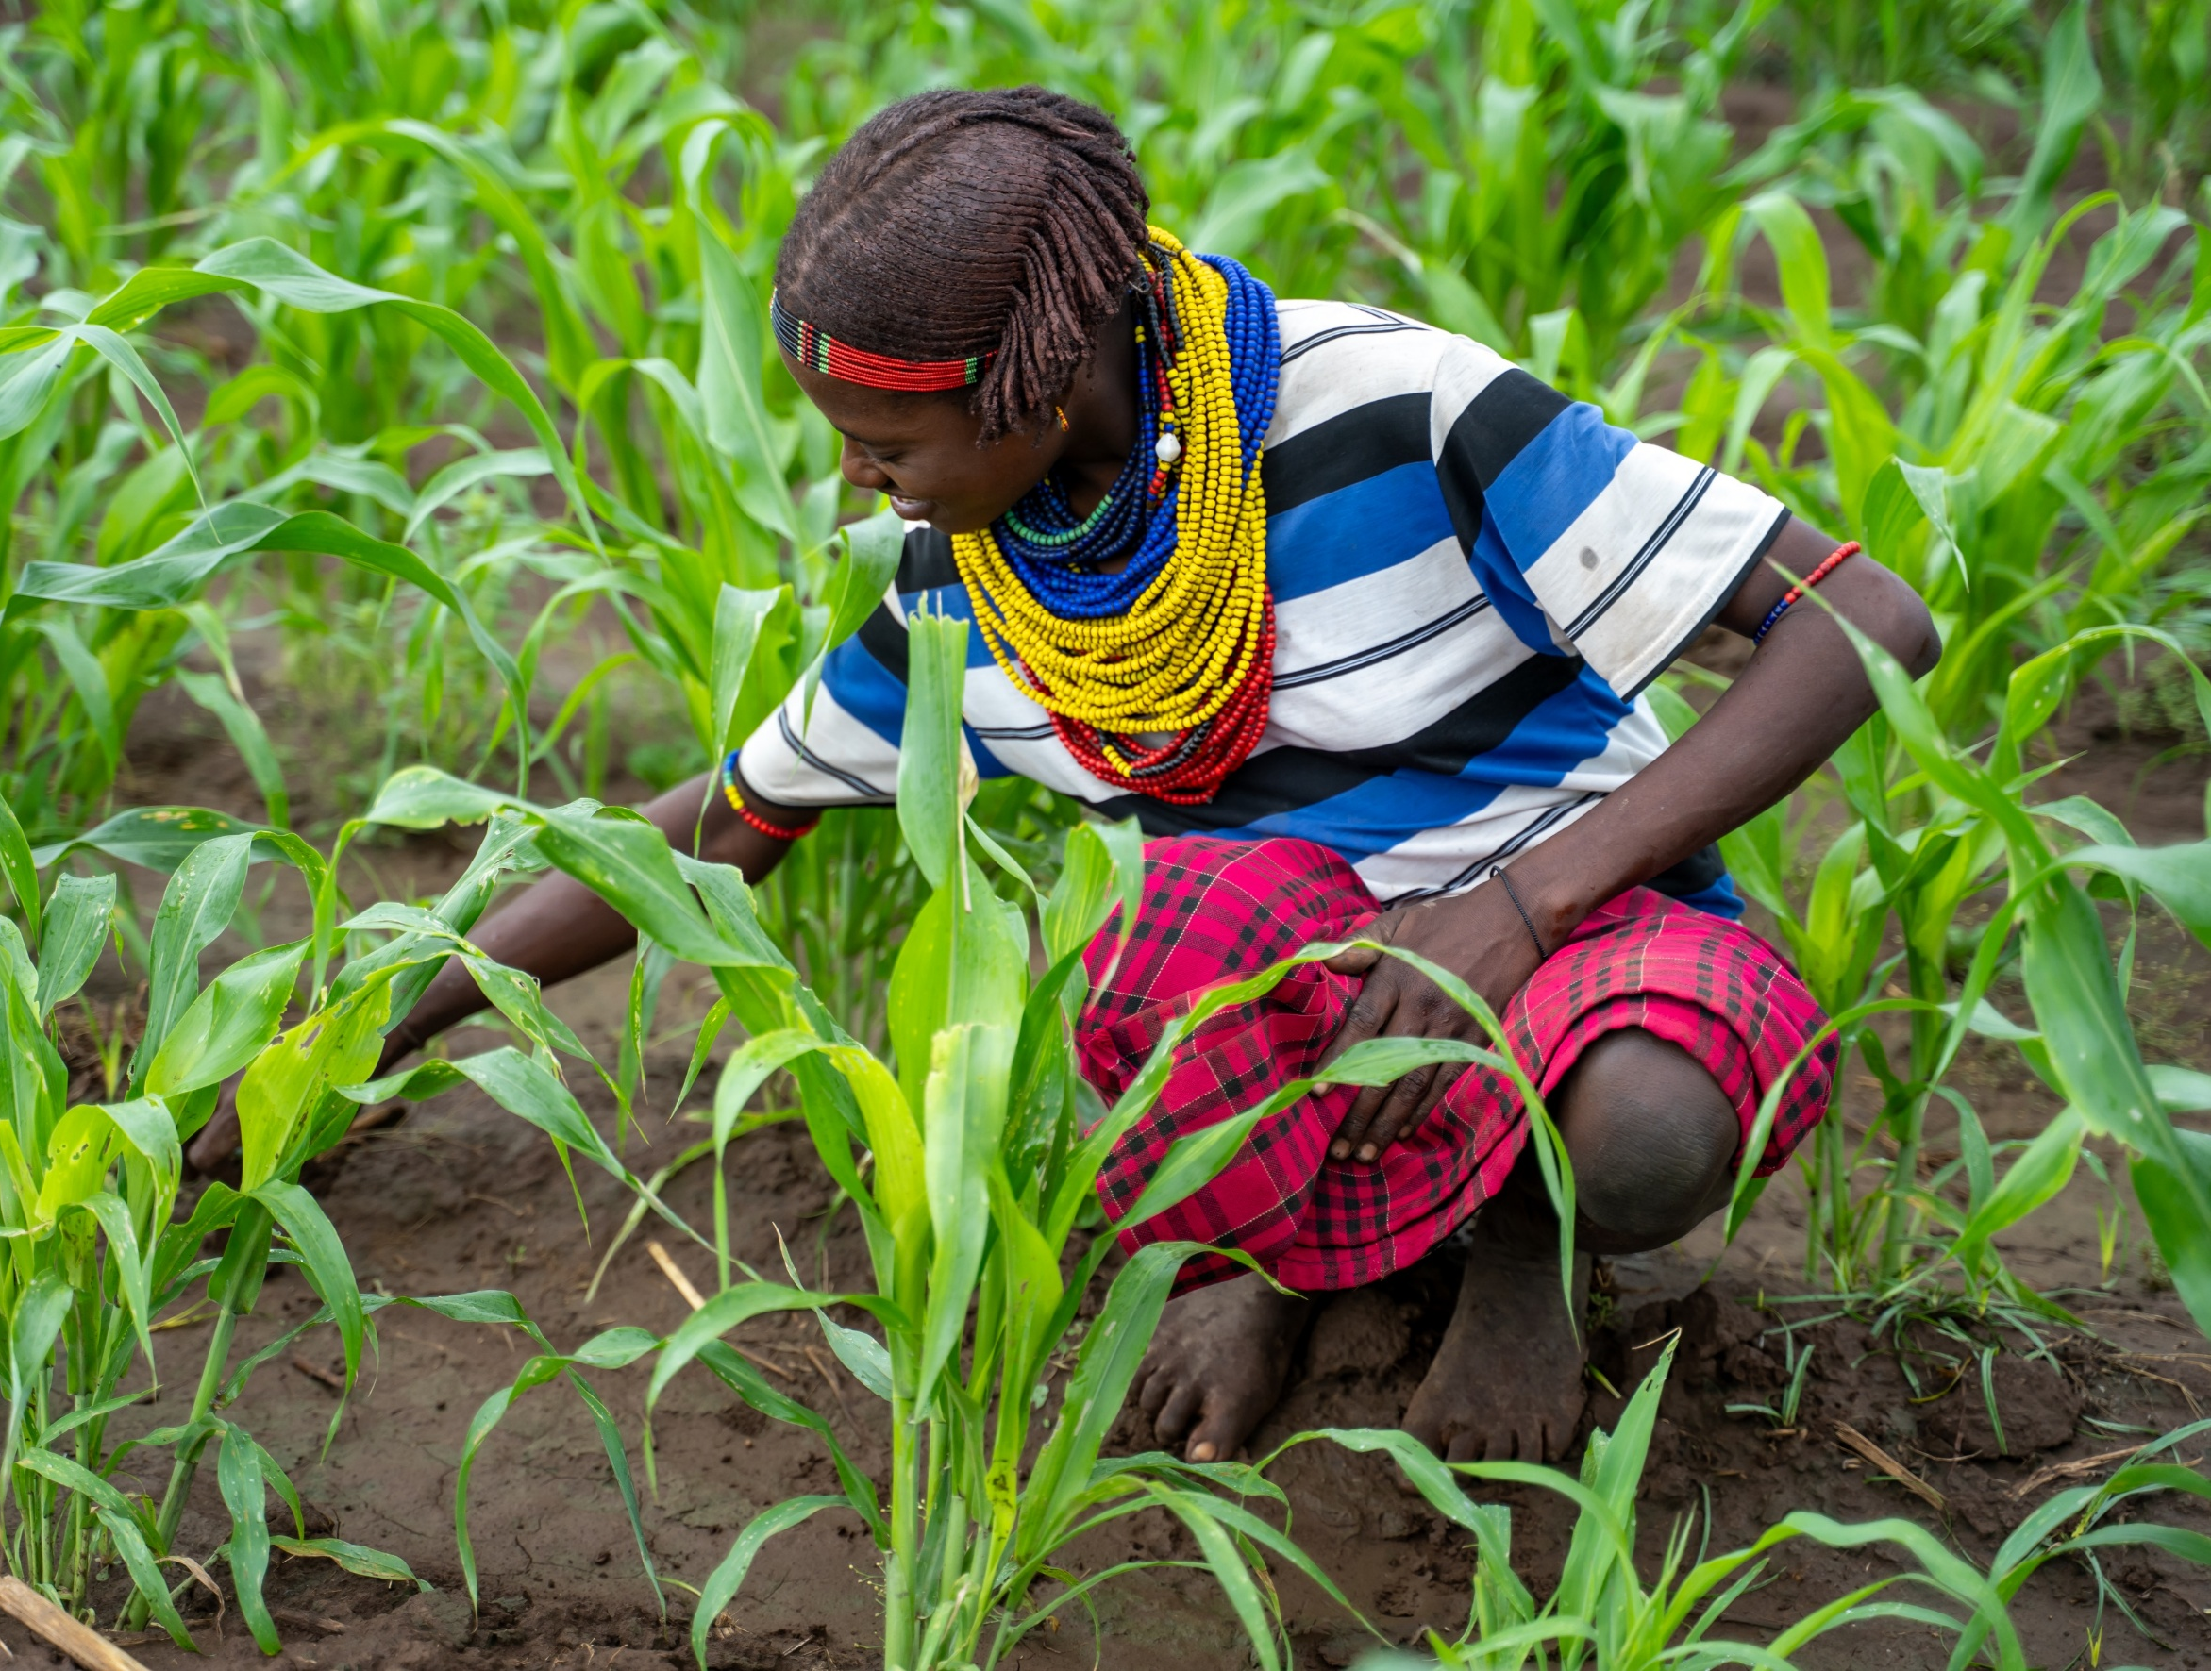

We're happy because we’re eating food from our harvest.
Donnay
Notes:
Donnay also says: "Our children are now able to get enough food. The support we received has improved our living conditions."

Slide 9
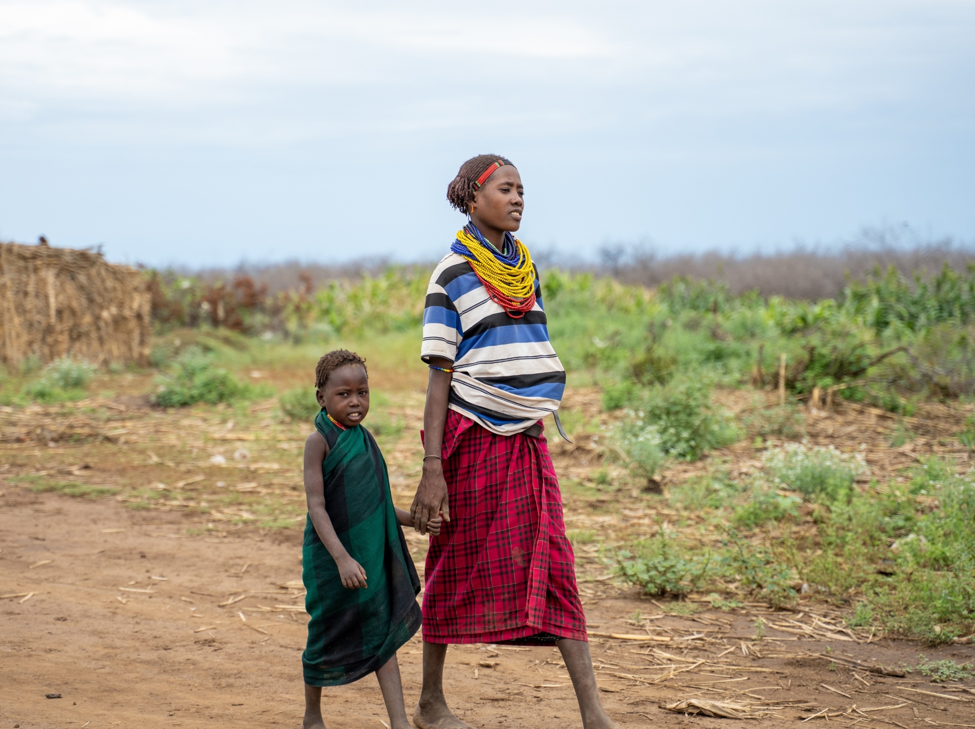

I hope to work hard and give my children a better future.
Donnay
Notes:
Donnay's story does not end with the flood. The support Donnay received has helped her family start farming again. Today, she is looking ahead and working towards a better future for her children.

Slide 10
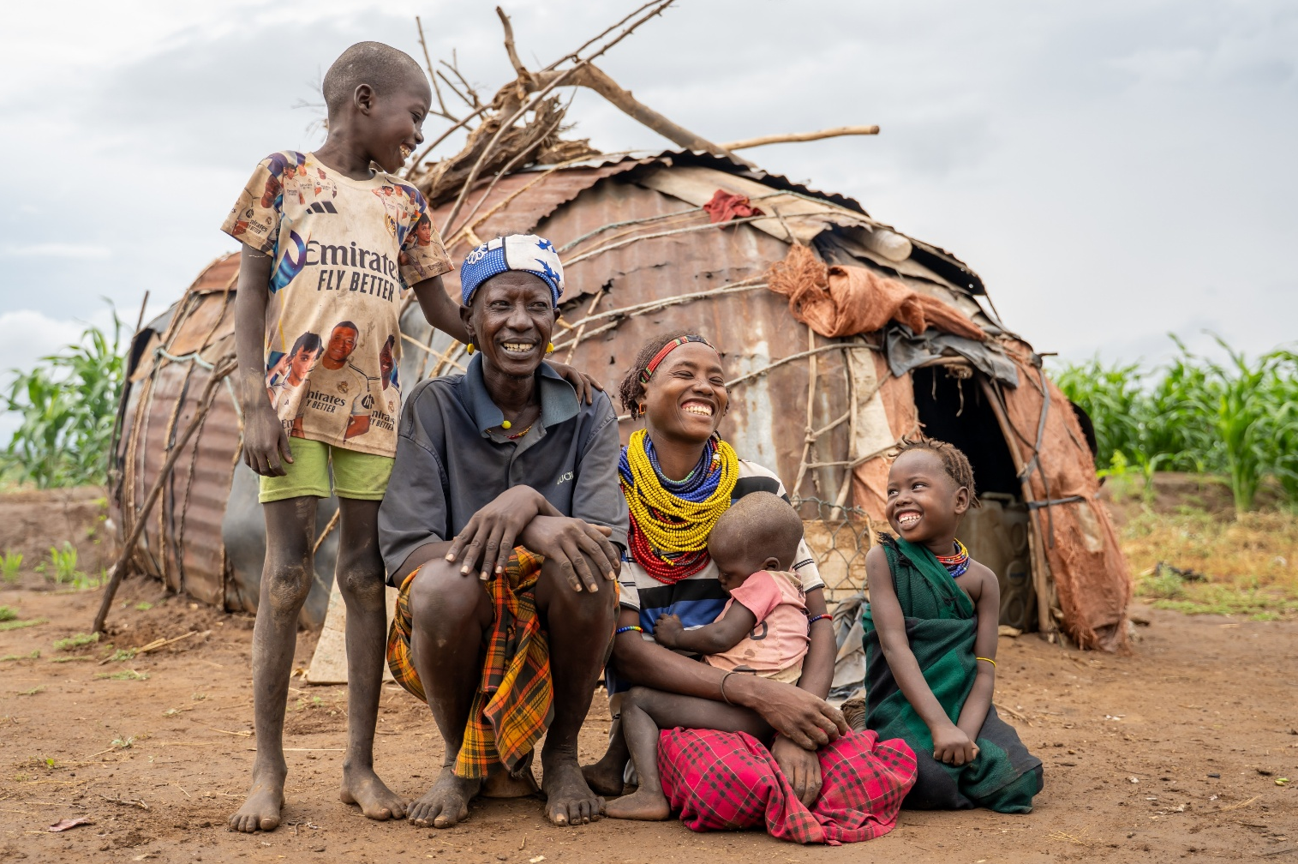

This Christmas, will you support a mother like Donnay to rebuild her farm and feed her family?
scan the QR code or visit caid.org.uk/DonateChristmas to donate
*Donate today and your gift will be doubled until our total Christmas Appeal income reaches £105,000. Subsequent donations won’t be matched but will still go to this appeal.
Notes:
Donnay's story shows both the impact of devastating floods and the difference practical support can make. Through Agri Service Ethiopia, Christian Aid is helping families rebuild their livelihoods, grow food and adapt to unpredictable flooding.
This appeal is an opportunity to support more families as they rebuild for the future.

Slide 11

Closing prayer
Almighty God,
at the birth of your Son,
the angels proclaimed the good news:
freedom from fear, peace on earth,
joy in abundance.
Send us out to live according to this marvellous promise.
Make us your messengers,
in our words and actions,
as we work to see your kingdom come on earth.
Amen.

Slide 12



Donate today
Scan me
or visit caid.org.uk/DonateChristmas
Christian Aid is member of
Eng and Wales charity no. 1105851 Scot charity no. SCO39150 Company no. 5171525 Christian Aid Ireland: NI charity no. NIC101631 Company no. NI059154 and ROI charity no. 20014162 Company no. 426928. The Christian Aid name and logo are trademarks of Christian Aid. © Christian Aid April 2026

